Slide 1
Email Activation Code with LoginTC App User Experience

Slide 2

Welcome to LoginTC
Today we'll explore how two-factor authentication keeps your accounts safe
Learn how to set up and use LoginTC app from the Email Activation Code

Slide 3
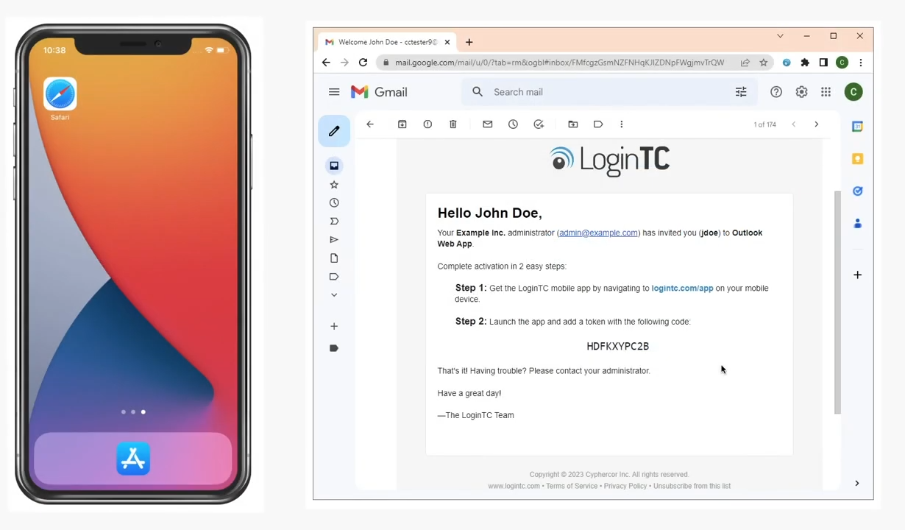
Getting Started: Receive Your Activation Code
Check your email from the IT administrator
Look for a 10-character activation code
Prepare to download the Login TC app

Slide 4
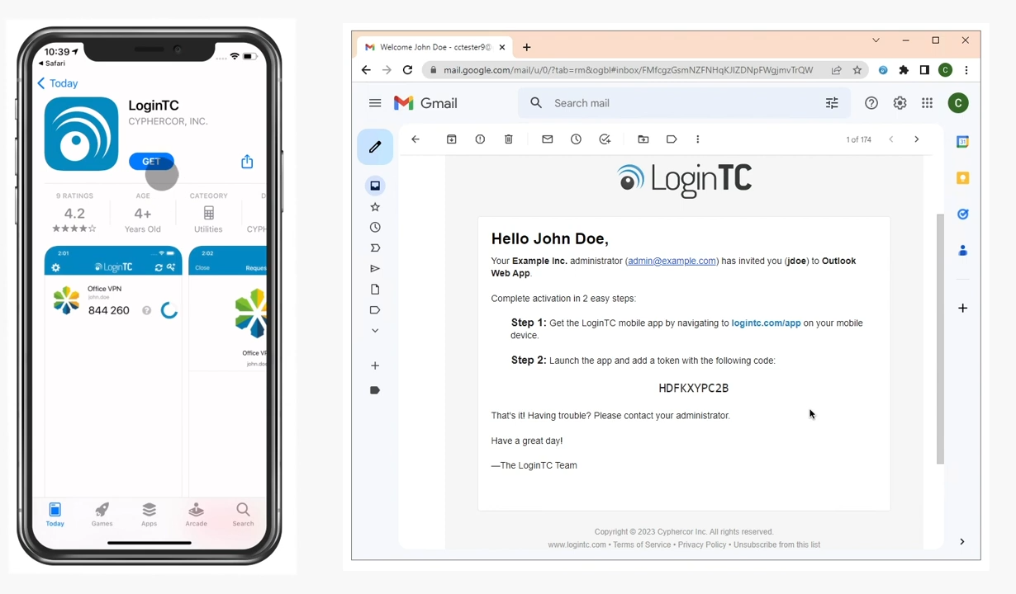
Download and Install the App
Visit logintc.com/app
Select your device type (iOS or Android)
Download the Login TC app
Install the application on your mobile device

Slide 5
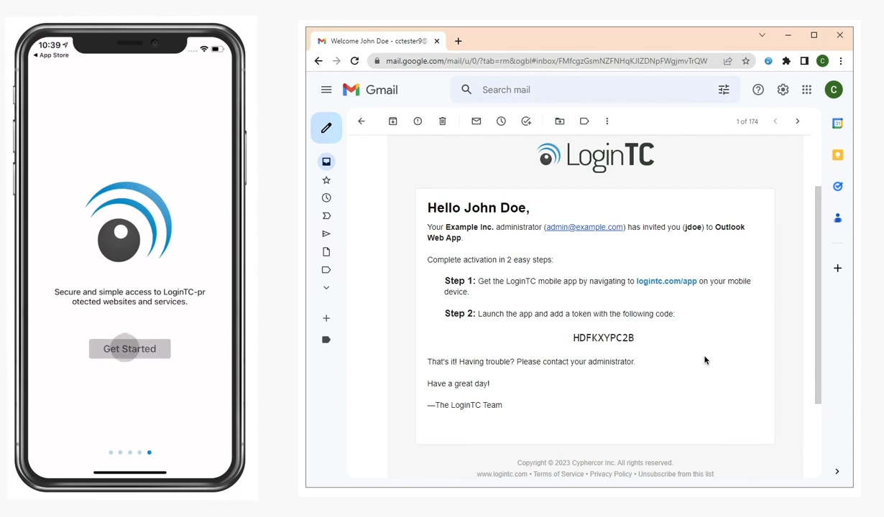
App Setup: Initial Configuration
Swipe through initial app introduction cards
Click "Get Started"
Allow notifications
Select "Add Token"

Slide 6
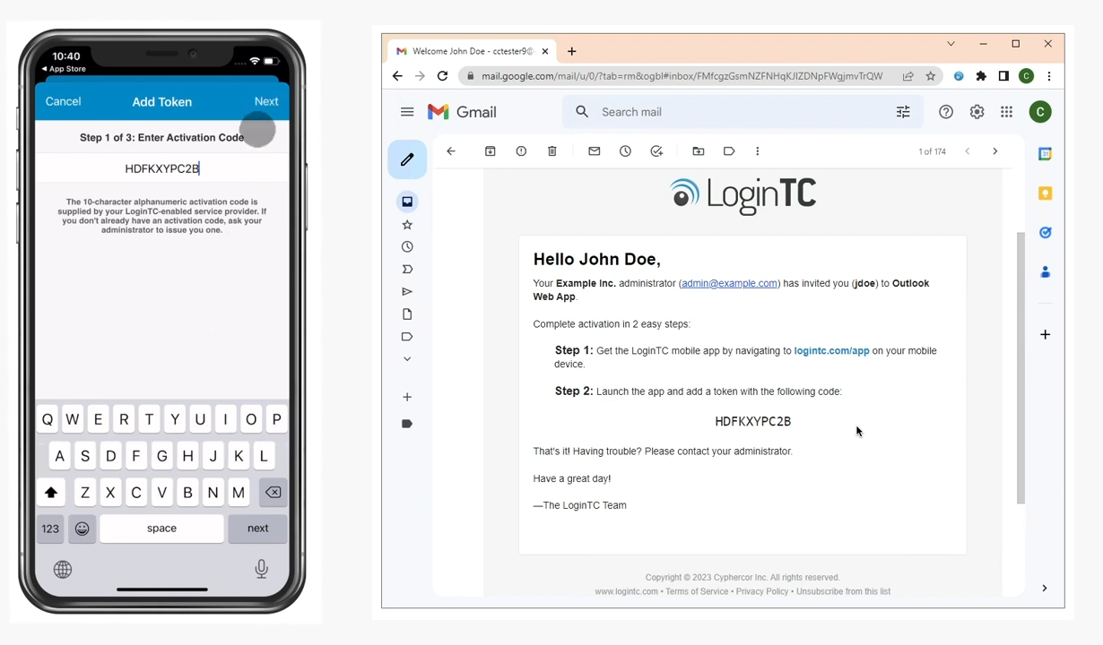
Entering Your Activation Code
Open the Login TC app
Select "Add Token"
Enter the 10-character activation code
Verify your account information

Slide 7
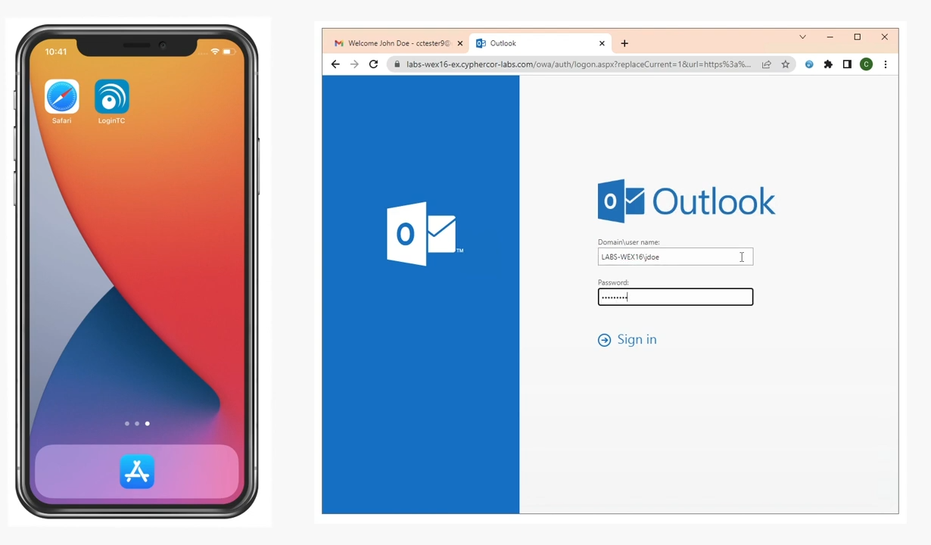
Login Process with LoginTC
Enter your first-factor credentials
Receive a push notification on your Login TC app
Review the login request
Approve or deny the login attempt

Slide 8
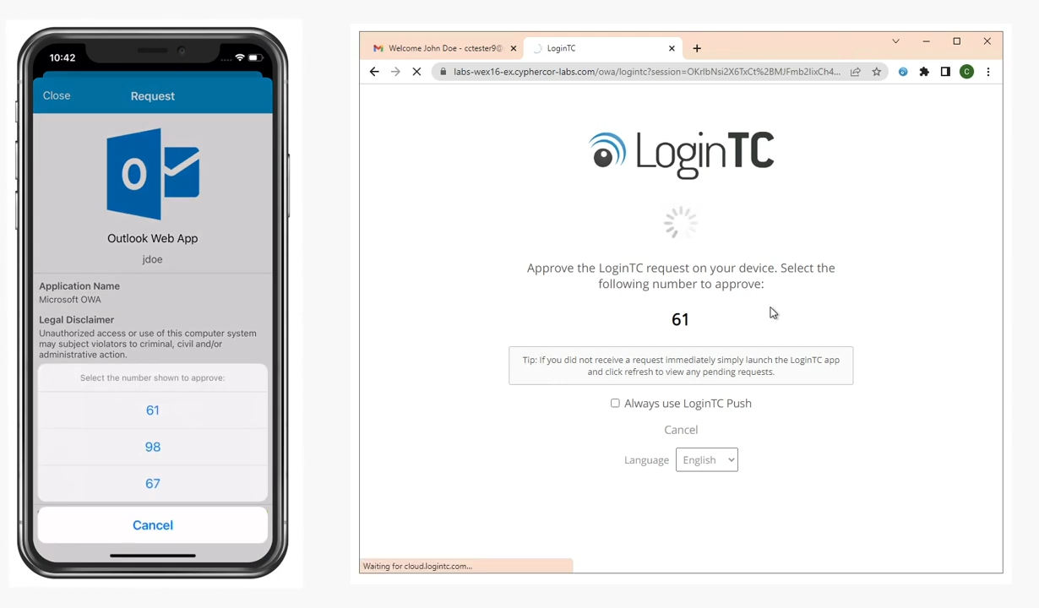
Matching Security Numbers
Compare the number on your browser screen
Match the number in the LoginTC App notification
Select the correct option to confirm your identity

