Slide 1
LoginTC: Two-Factor Authentication for Beginners
Notes:
Created from: https://www.youtube.com/watch?v=ux_d4RnqVpo

Slide 2

Introduction to LoginTC
Today we'll learn about two-factor authentication (2FA)
Discover how to protect your online accounts
Learn step-by-step login process for LoginTC

Slide 3
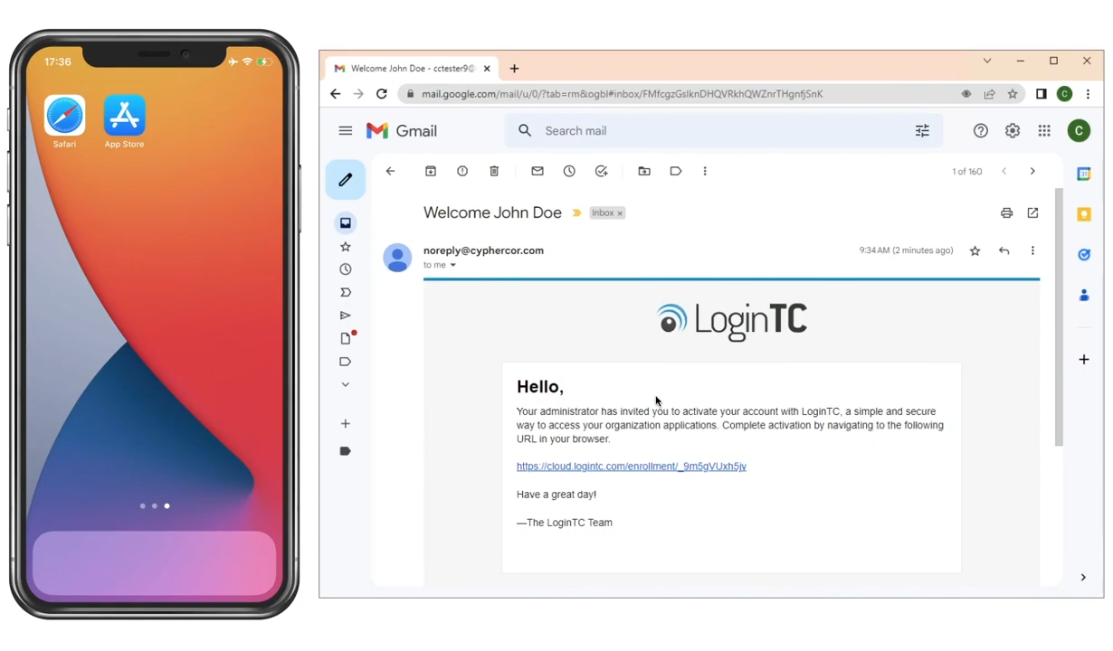
Getting Started: Enrollment
Receive an activation email from your IT administrator
Visit logintc.com/app on your device
Choose your device type (mobile or desktop)
Download the LoginTC app

Slide 4
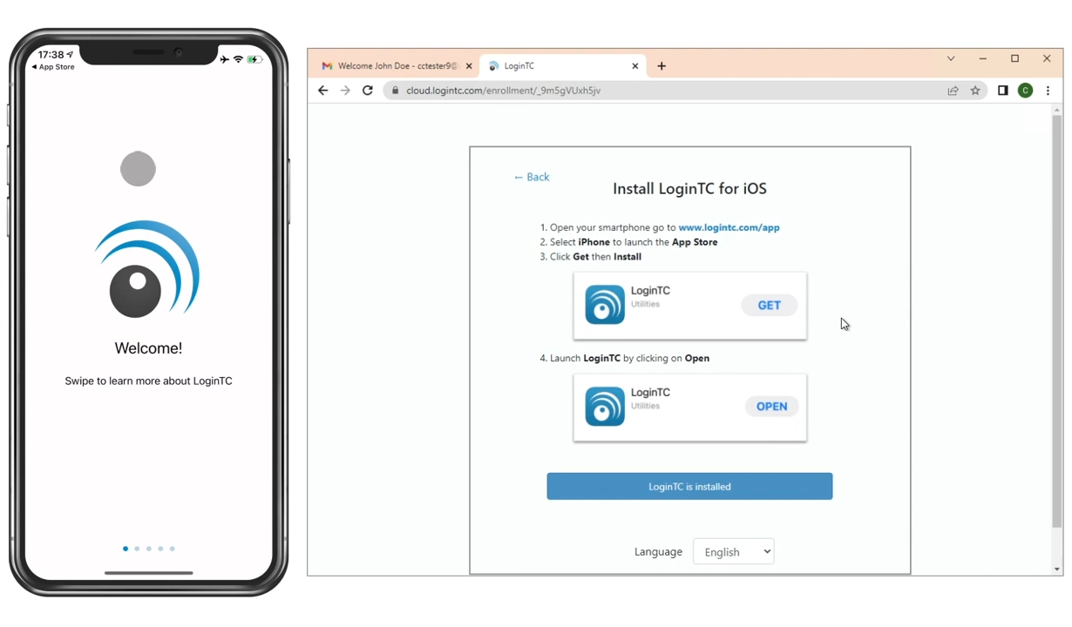
App Installation Process
Swipe through app introduction cards
Click "Get Started"
Allow notifications
Select "Add Token"
Enter 10-character activation code

Slide 5
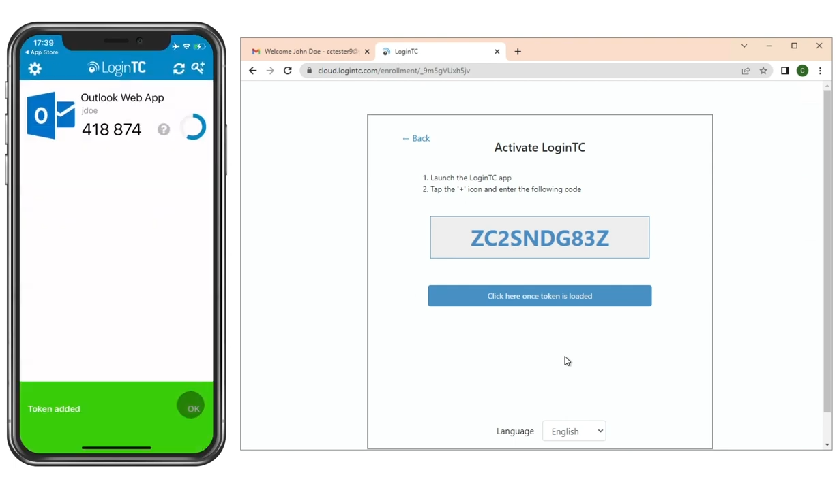
Verifying Your Enrollment
A window will show your token details
Check your username
Confirm logo and account information
Click "Add" to complete enrollment

Slide 6
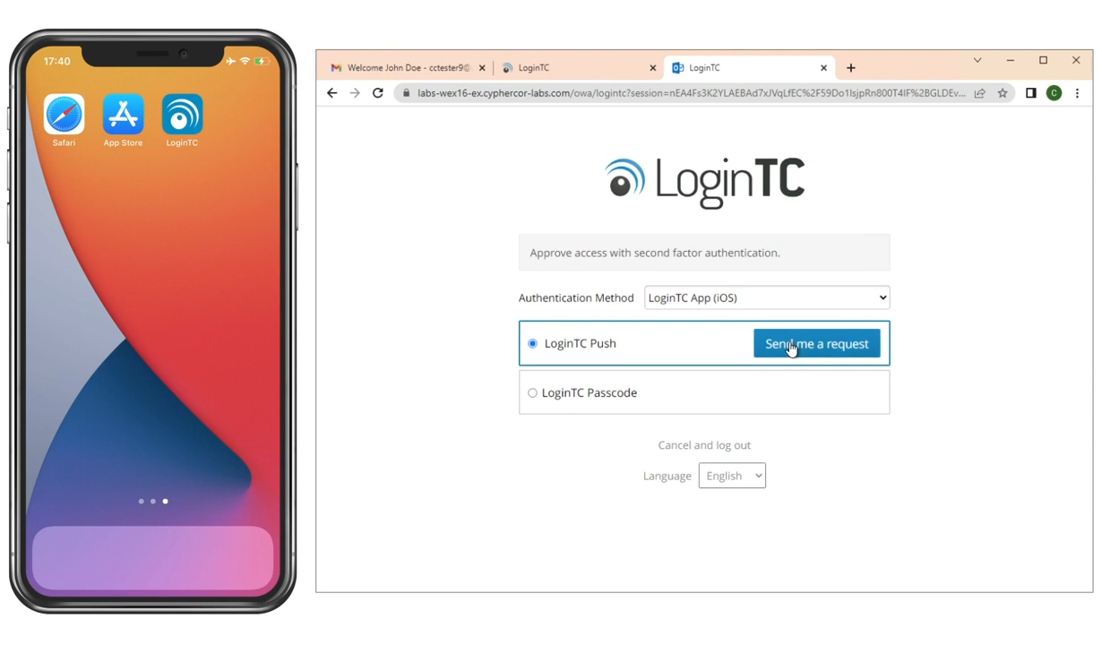
Logging in: Requesting authentication
Go to your protected application
Enter first-factor credentials (username/password)
Wait for second-factor authentication challenge
Select "LoginTC Push"
Click "Send Me a Request"

Slide 7
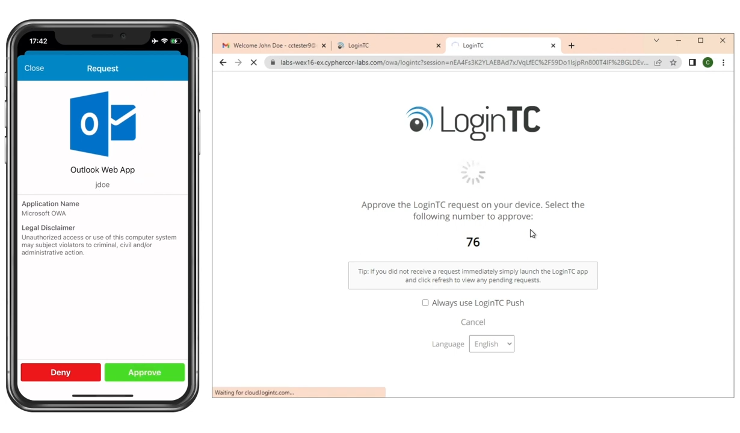
Logging in: Approving authentication
Receive notification on your mobile device
Open the authentication request
Review the login attempt
Confirm if the request is legitimate
Click "Approve"

Slide 8
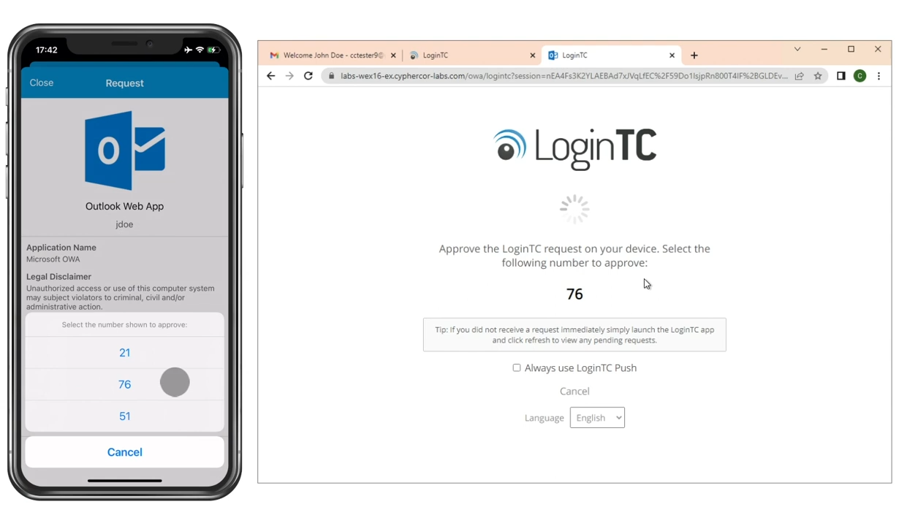
Number Matching Security
Match the number on your browser screen
Select the correct corresponding option
Complete the login process

Slide 9

Why Two-Factor Authentication Matters
Prevents unauthorized account access
Protects personal and professional information
Adds an extra layer of digital security

