Slide 1
LoginTC Enrollment Link with Passcode Grid Tutorial
Notes:
Created from: https://www.youtube.com/watch?v=cjDU4Ukhxq0&t=6s

Slide 2

Welcome to LoginTC Authentication
Today we'll explore a secure login method called LoginTC Two-Factor Authentication (2FA)
Learn how to enroll and use two-factor authentication
Understand why extra security matters for digital accounts

Slide 3

What is Two-Factor Authentication?
An extra layer of security beyond passwords
Requires two different types of identification
Helps protect your digital accounts from unauthorized access
Like having a second lock on your digital door

Slide 4
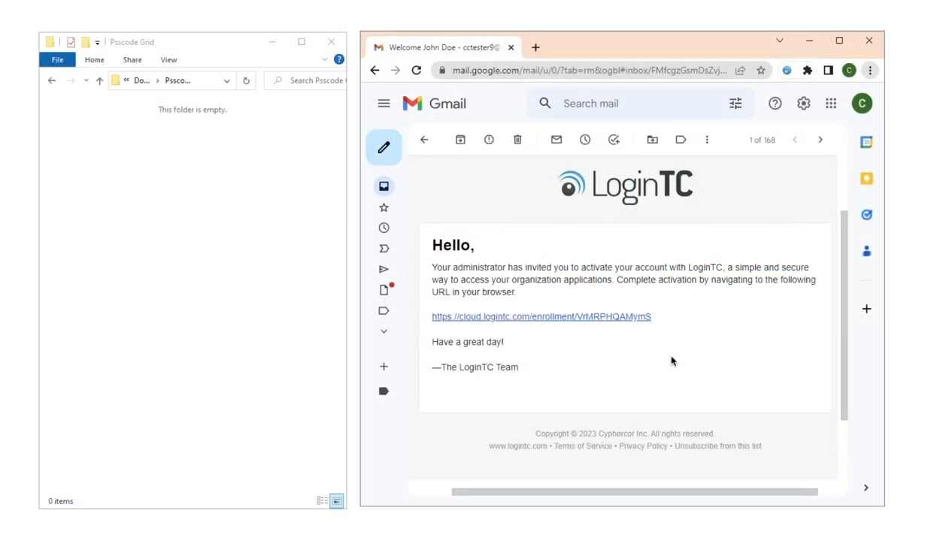
Enrollment: Getting Started
Click the enrollment link sent by your IT administrator
Open the enrollment portal
Select "Start Enrollment"
Choose the passcode grid option

Slide 5
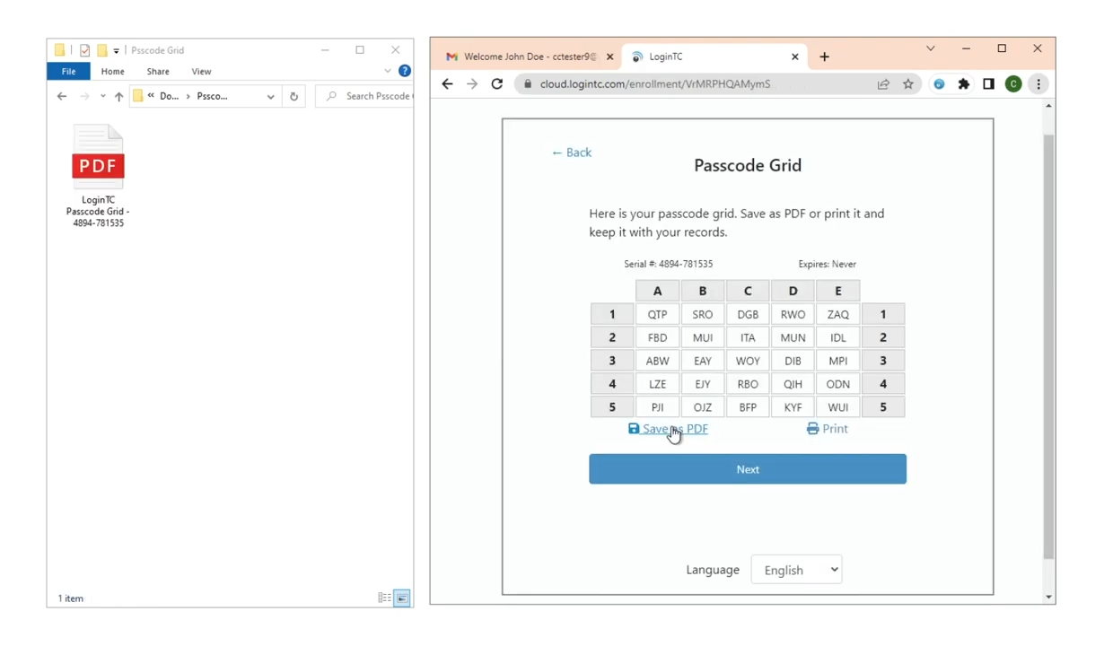
Your Unique Passcode Grid
Receive a personalized grid with letters and numbers
Save the grid as a PDF or print it out
Keep your grid in a safe, secure location
Click "Next" to verify enrollment

Slide 6
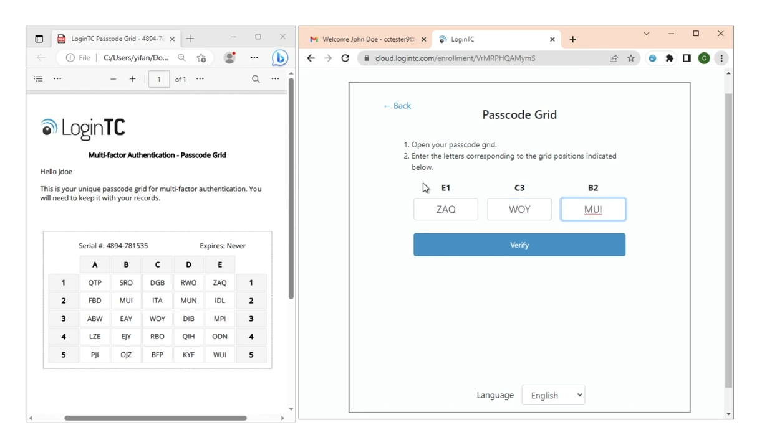
Verification Process
Open your saved passcode grid
Enter letters corresponding to requested grid positions
Click "Verify" to complete enrollment
Confirm your successful registration

Slide 7
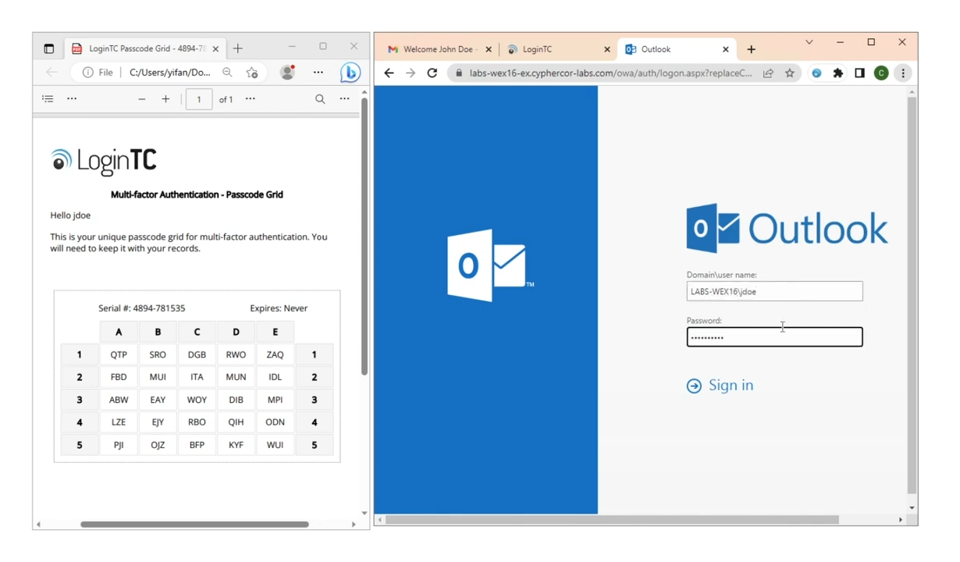
Login Process: First Factor
Go to your Login TC protected application
Enter your first factor credentials (username/password)
Prepare for the second authentication challenge

Slide 8
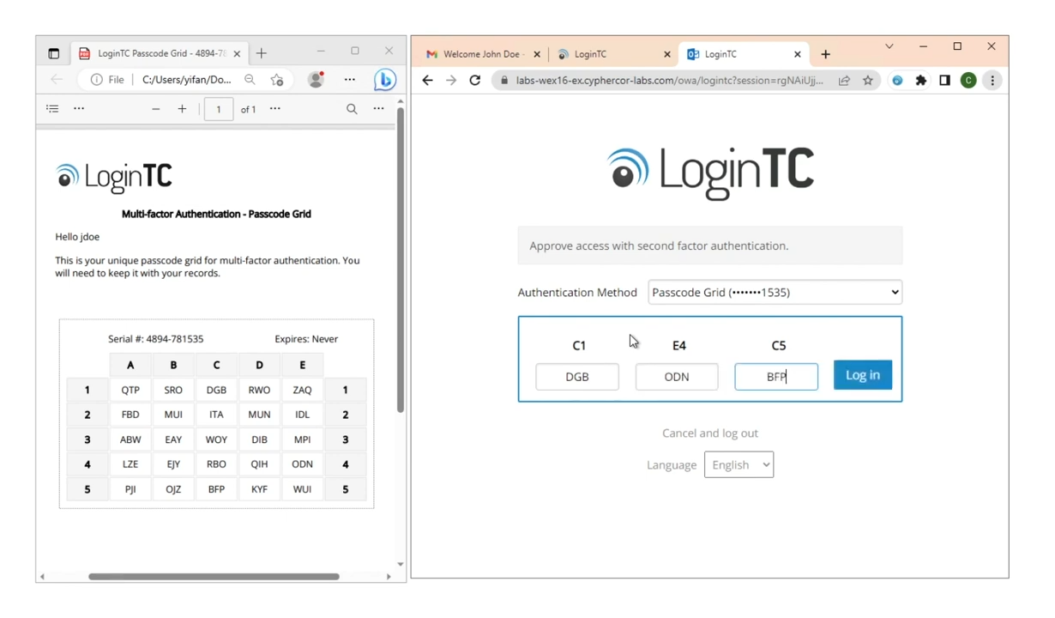
Login Process: Second Factor
Select "Passcode Grid" option
Locate the requested grid positions
Enter corresponding letters from your grid
Click "Login"

Slide 9

Best Practices
Keep your passcode grid private
Don't share your grid with anyone
Store your grid securely
Inform your IT manager if your grid is lost or compromised

