Slide 1
LoginTC Enrollment: Security Key Authentication
Notes:
Created from: https://www.youtube.com/watch?v=8EH4CmoWiEs

Slide 2
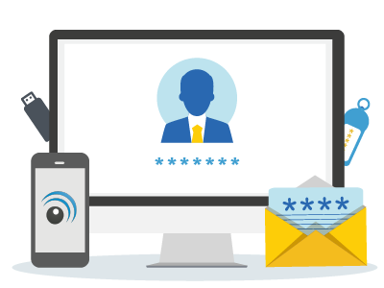
Welcome to LoginTC Security Key Enrollment
Today we'll explore how to use a security key for login
Learn about a new way to protect your digital accounts
Understand step-by-step enrollment process

Slide 3
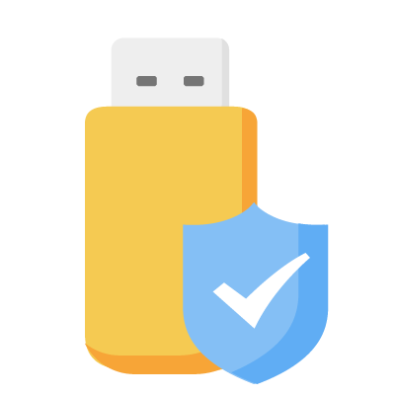
What is a Security Key?
A physical device that adds extra protection to your login
Helps prevent unauthorized access to your accounts
Works like a special digital key for your computer

Slide 4
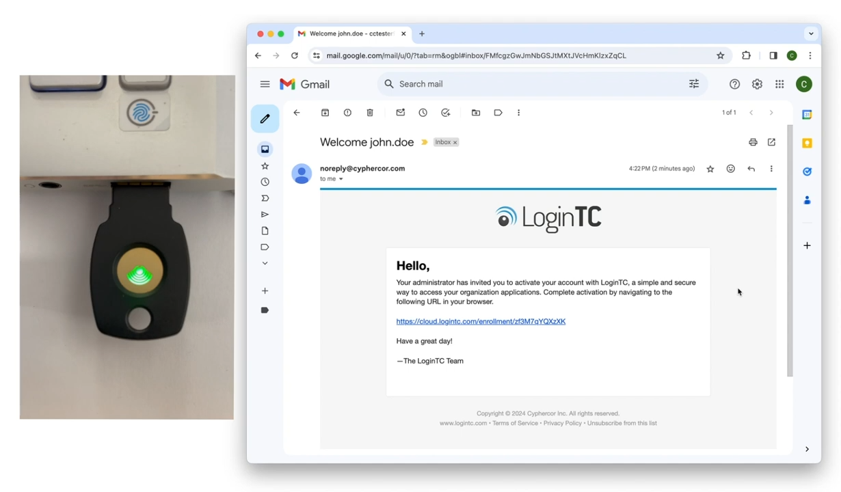
Getting Started: Enrollment Email
Look for an email from your IT administrator
Click the enrollment link provided
Open the Login TC enrollment portal

Slide 5
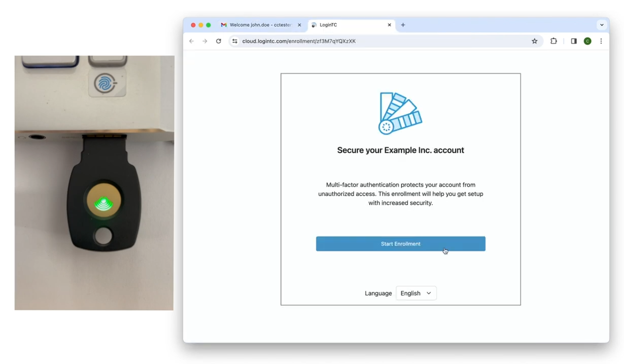
Starting the Enrollment Process
Click "Start Enrollment"
Select "Security Key" from authentication methods
Prepare your physical security key

Slide 6
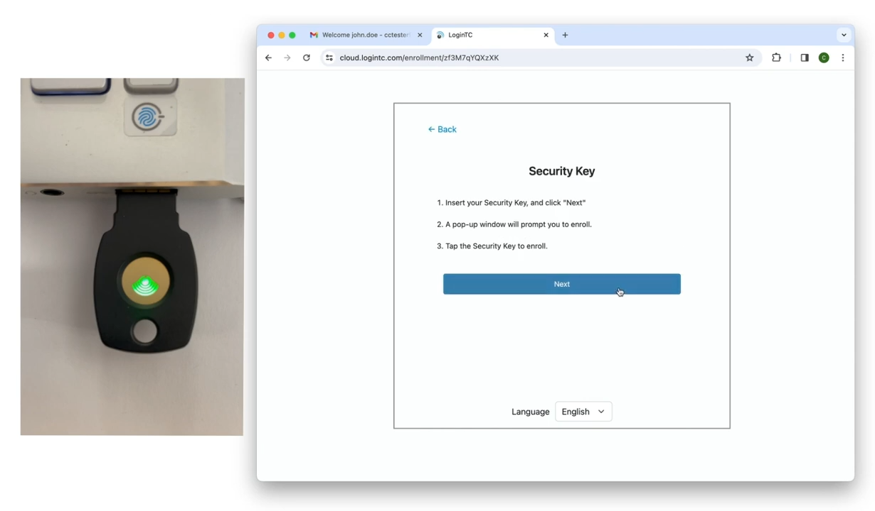
Inserting Your Security Key
Plug the security key into your computer
Click "Next" in the browser window
Be ready to interact with browser prompts

Slide 7
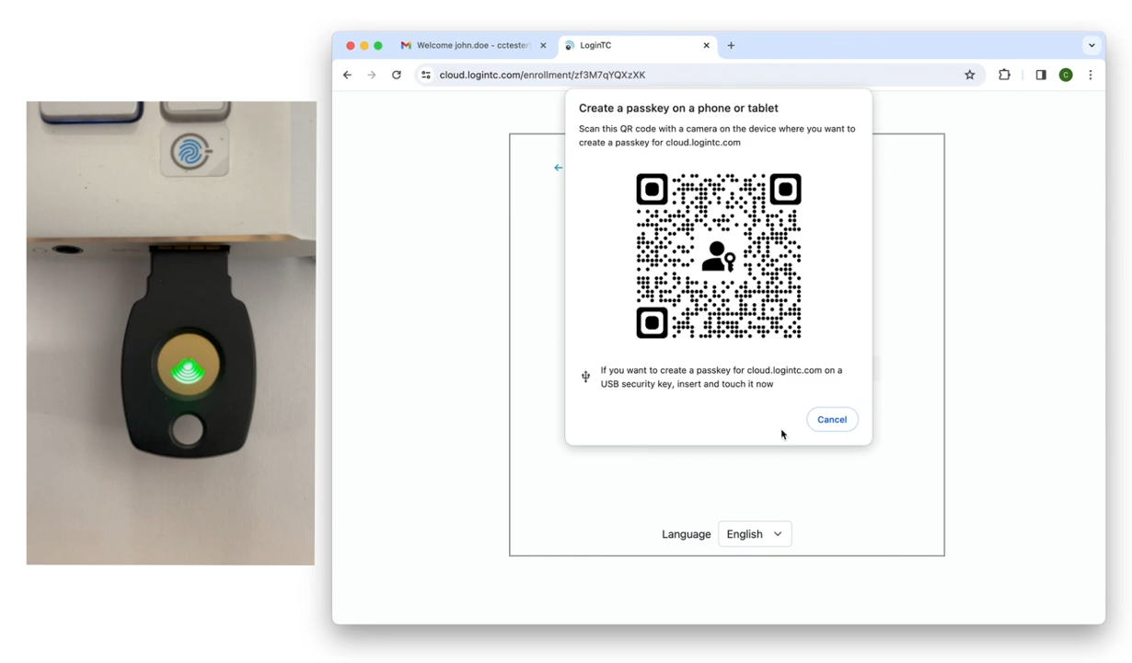
Creating Your Passkey
Browser will ask to create a passkey
Tap the button on your security key
Allow the site to recognize your key

Slide 8
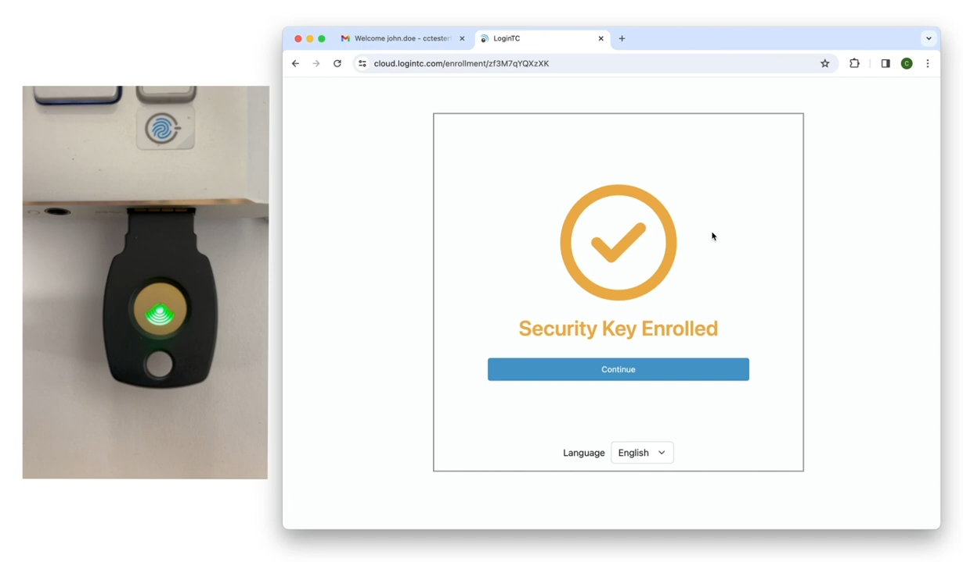
Completing Enrollment
Confirm your security key is enrolled
Click "Continue"
Exit the enrollment portal

Slide 9
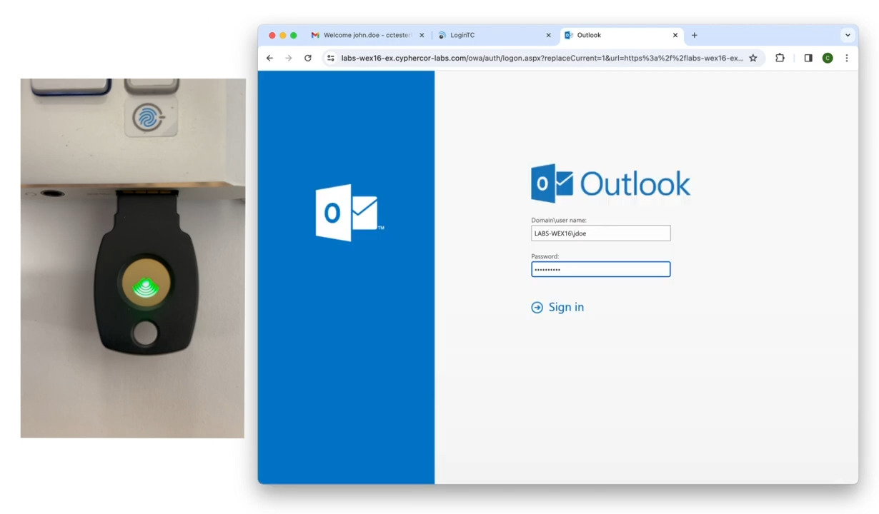
Using Your Security Key
Go to your protected application
Enter first factor credentials
Select "Security Key" from dropdown

Slide 10
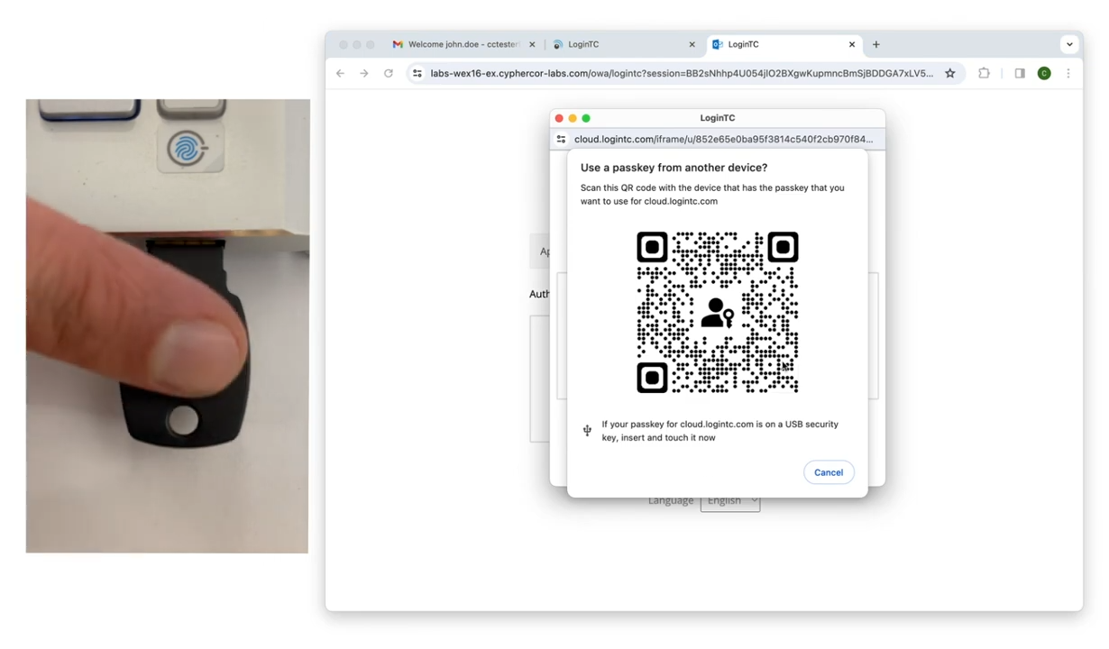
Final Authentication
Insert your security key
Tap the button when prompted
Successfully log in to your account

