Slide 1
LoginTC Enrollment and Authentication: A Step-by-Step Guide
Notes:
Created from: https://www.youtube.com/watch?v=PvJtU8HAs54

Slide 2
Introduction to LoginTC
LoginTC is a multi-factor authentication (MFA) system
Enhances security for accessing protected applications
Today we'll learn how to enroll and use LoginTC with Google Authenticator
Notes:
Image from: https://www.istockphoto.com/illustrations/multi-factor-authentication-icon

Slide 3
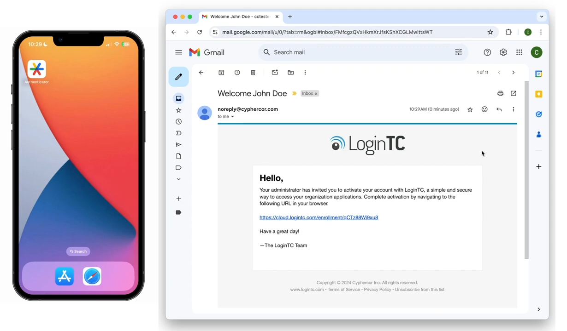
Getting Started: Enrollment
Check your email for the enrollment link from your IT administrator
Click on the enrollment link to begin the process
In the enrollment portal, click "Start enrollment"
Notes:
Image from: https://www.e-verify.gov/quick-reference-guide-for-e-verify-enrollment-20-enrollment/22-enrollment-process

Slide 4
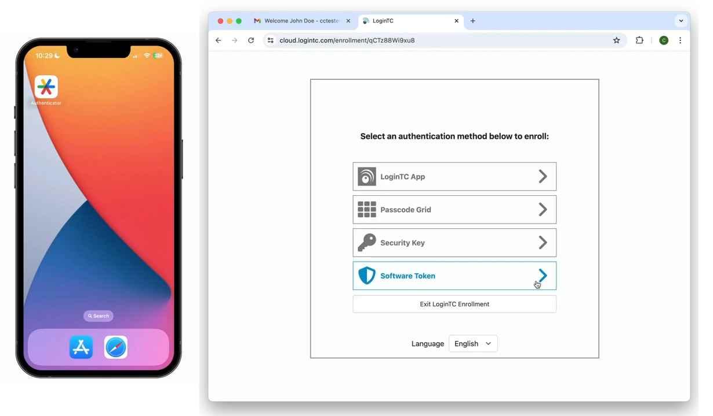
Choosing Authentication Method
From the authentication methods list, select "Software Token"
This option allows you to use Google Authenticator app
A QR code will appear on your screen

Slide 5
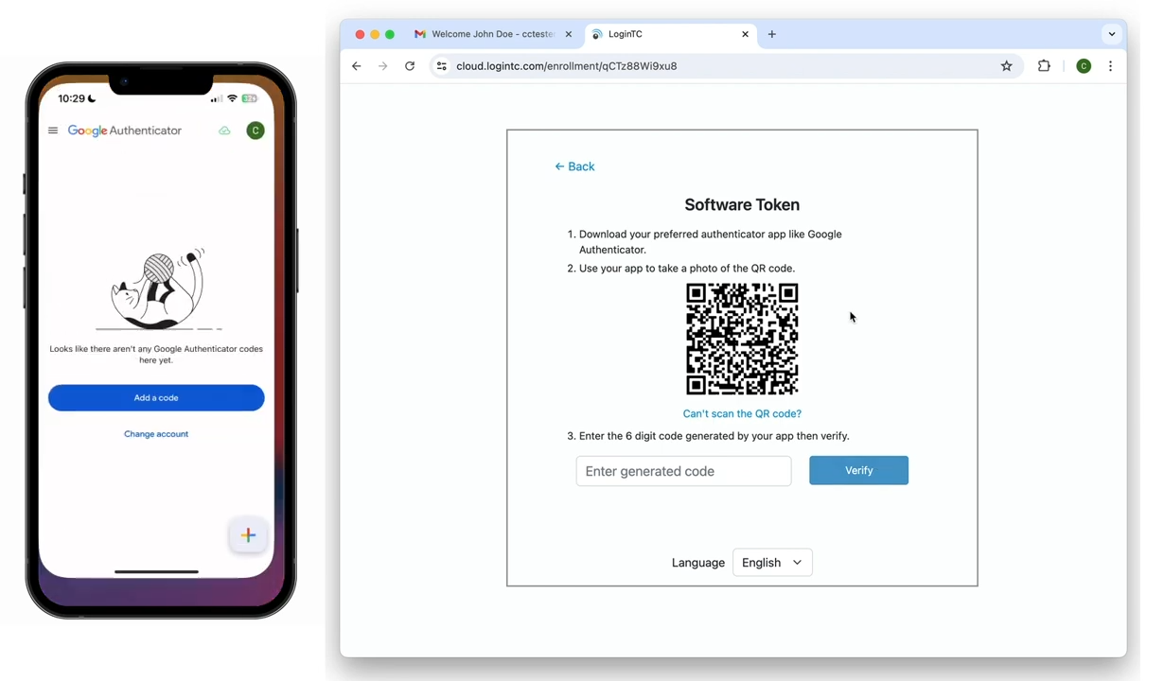
Setting Up Google Authenticator
Open the Google Authenticator app on your mobile device
Tap "Add a code" or the "+" icon
Select "Scan a QR code"
Use your device's camera to scan the QR code shown in your browser
Notes:
Image from: https://doit.missouri.edu/use-microsoft-authenticator-app-to-avoid-disruptions/

Slide 6
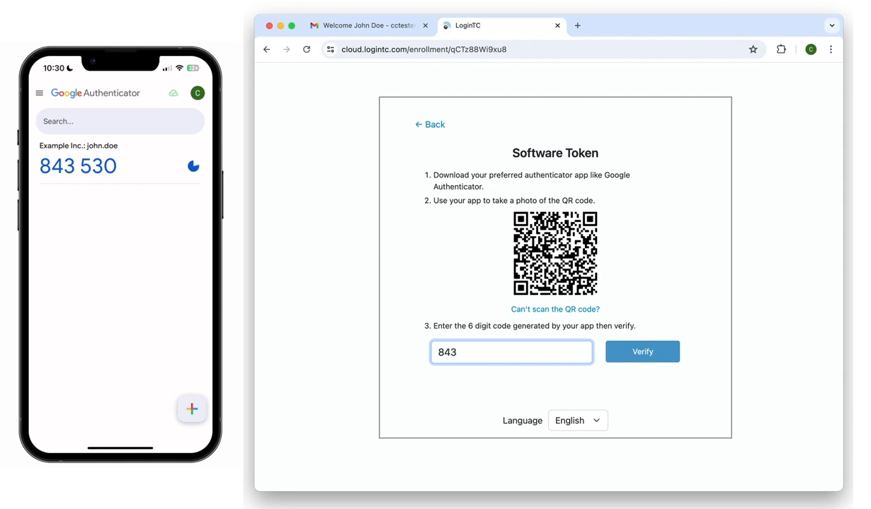
Verifying Your Enrollment
After scanning, a 6-digit code will appear in the Google Authenticator app
Enter this code into the space provided in your browser
Click "Verify" to complete the enrollment
Notes:
Image from: https://www.wearewibble.com/wibble-support-add-2-factor-authentication-to-your-wibble-webmail/

Slide 7
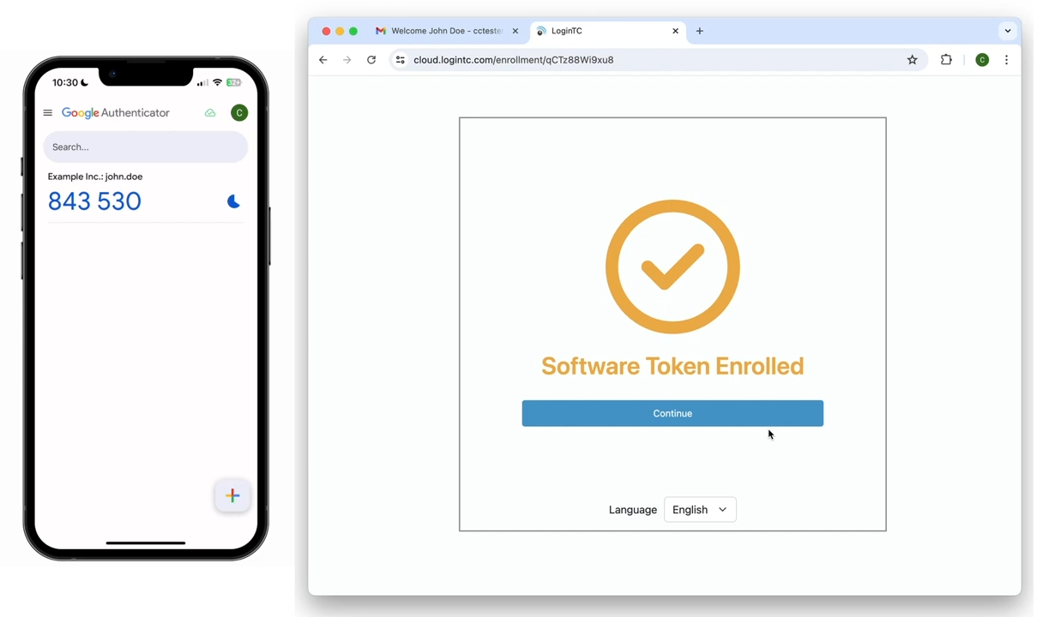
Completing the Enrollment
Once verified, you've successfully enrolled your software token device
Click "Continue" to exit the LoginTC enrollment process
Your account is now set up for multi-factor authentication

Slide 8
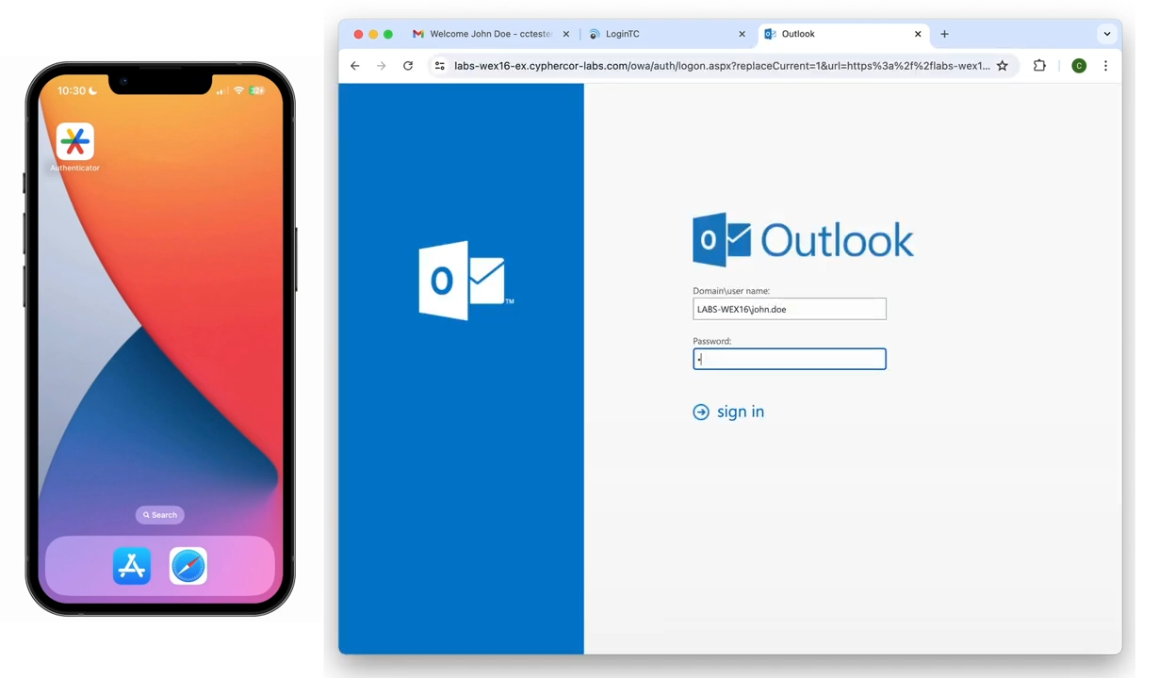
Logging In: First Factor
Navigate to your LoginTC protected application
Enter your usual credentials (username and password)
This serves as your first factor of authentication
Notes:
Image from: https://www.freepik.com/free-vector/member-login-form-template-with-username-password-design_269815242.htm

Slide 9
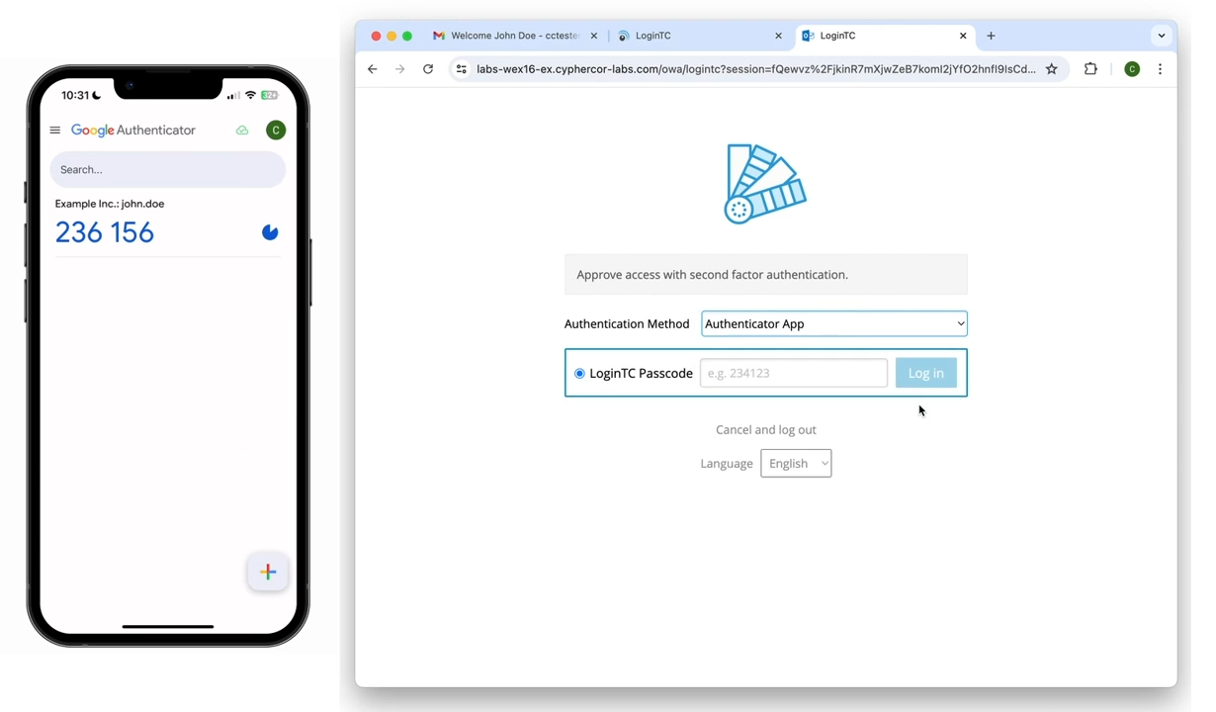
Second Factor: Google Authenticator
After entering first factor, you'll be prompted for the second factor
Select "Authenticator App" from the drop-down list
Open your Google Authenticator app
Locate the 6-digit code for your LoginTC account
Notes:
Image from: https://arstechnica.com/gadgets/2021/11/google-wants-every-account-to-use-2fa-starts-auto-enrolling-users/

Slide 10
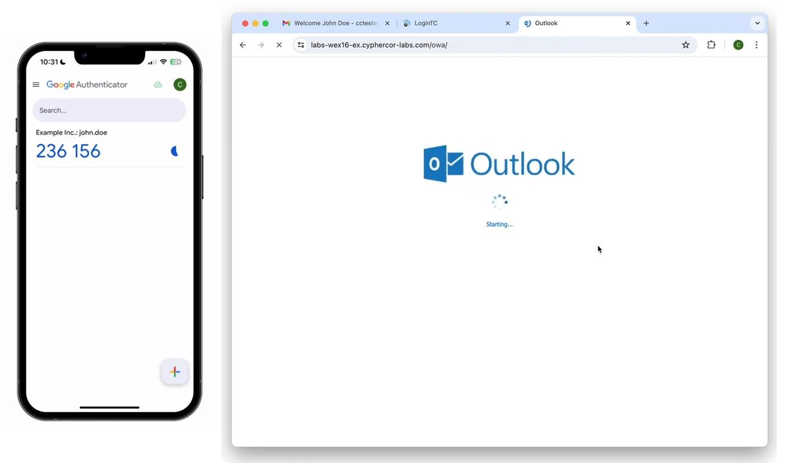
Completing the Login Process
Enter the 6-digit code from Google Authenticator into the browser
Click "Log In" to complete the authentication process
You're now successfully logged in with LoginTC multi-factor authentication

Slide 11
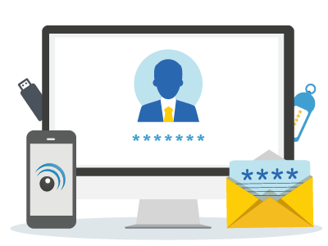
Recap and Best Practices
Always keep your Google Authenticator app and device secure
Never share your authentication codes with anyone
Regularly update your device and the Authenticator app
Contact IT support if you encounter any issues during enrollment or login
Notes:
Image from: https://www.coxblue.com/8-cyber-security-best-practices-for-your-small-to-medium-size-business-smb/

