Slide 1
LoginTC Managed Enrollment with FIDO2 Tokens User Experience
Notes:
Created from: https://www.youtube.com/watch?v=bQs7Q8K1L2A

Slide 2
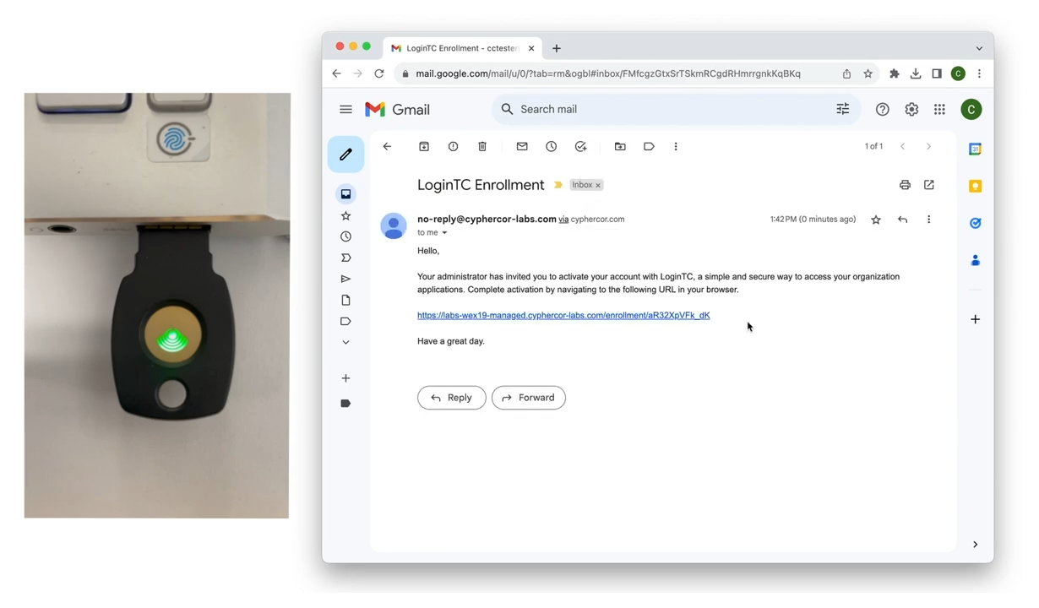
Getting Started with Login TC Enrollment
Look for an enrollment email from your IT administrator
Click the enrollment link
Follow the step-by-step instructions carefully

Slide 3
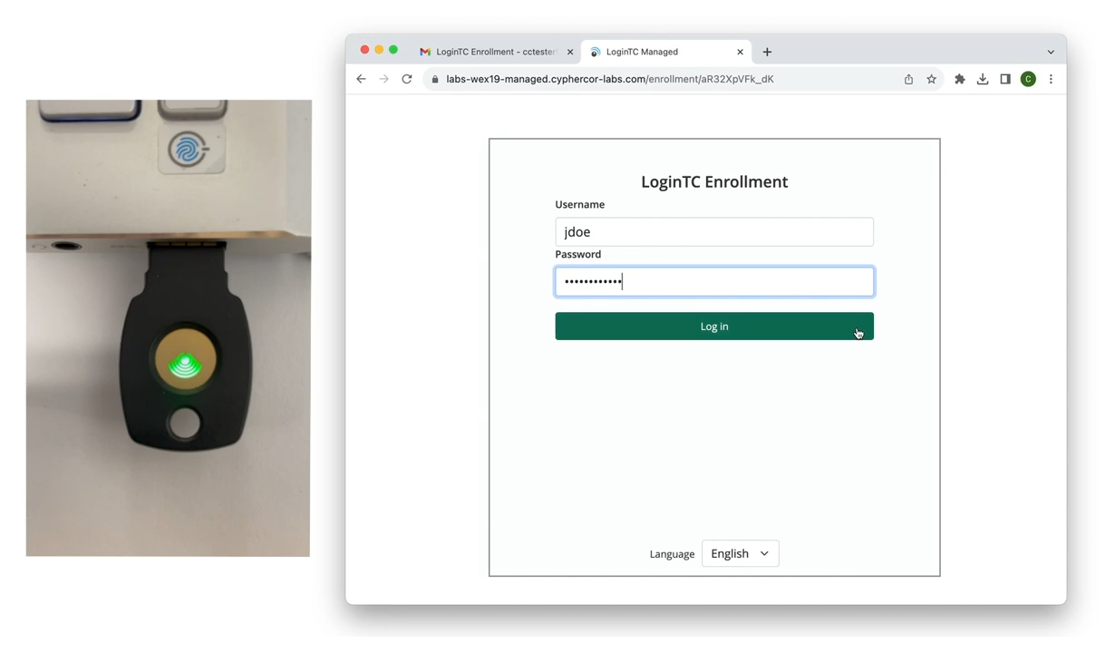
First Authentication Step: Username and Password
Enter your username
Input your password
Click login button

Slide 4
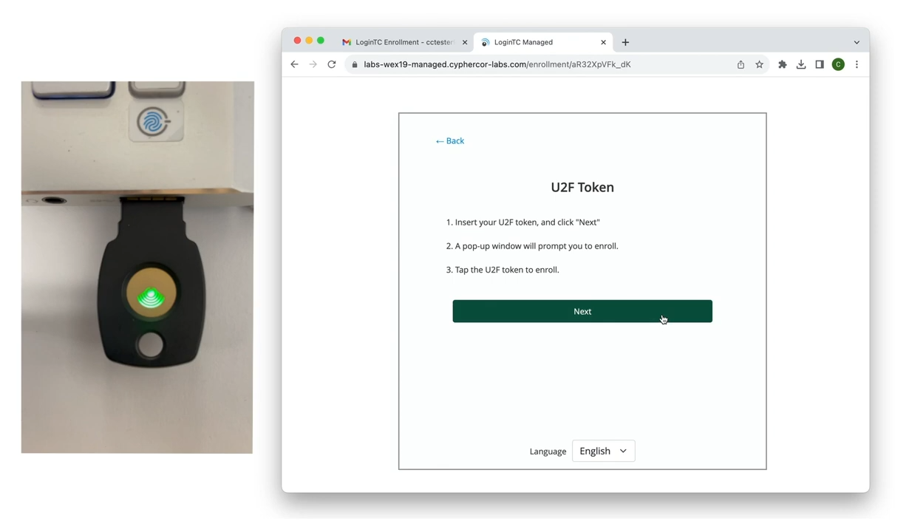
Selecting Your Authentication Method
Choose U2F token from authentication methods
Insert your security token into computer
Be prepared to interact with browser prompts

Slide 5
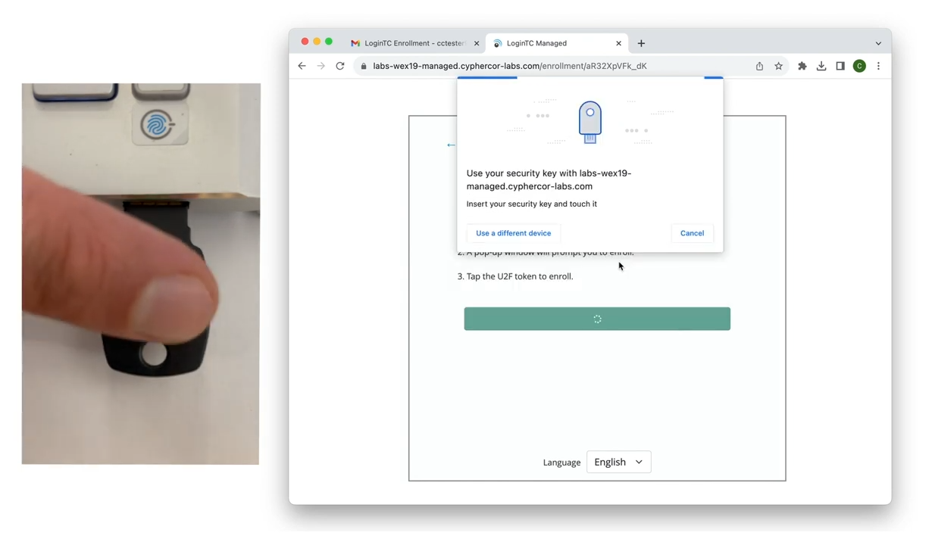
Token Enrollment Process
Click "USB Security Key"
Tap the button on your U2F token
Allow the site to recognize your security key
Complete the enrollment process

Slide 6
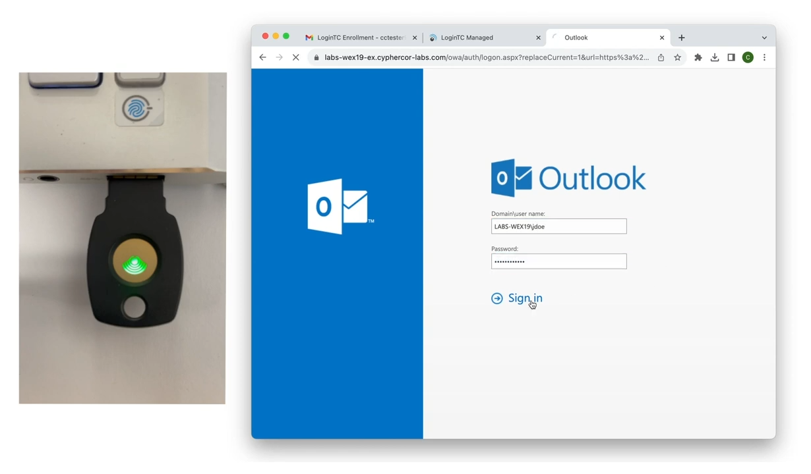
Logging In with Your New Token
Go to protected application
Enter first-factor credentials
Select "Security Key" option
Insert your U2F token
Tap the token button to authenticate

