Slide 1
LoginTC Managed Enrollment: A Step-by-Step Guide
Notes:
Created from: https://www.youtube.com/watch?v=mGIvnTnpWrM

Slide 2
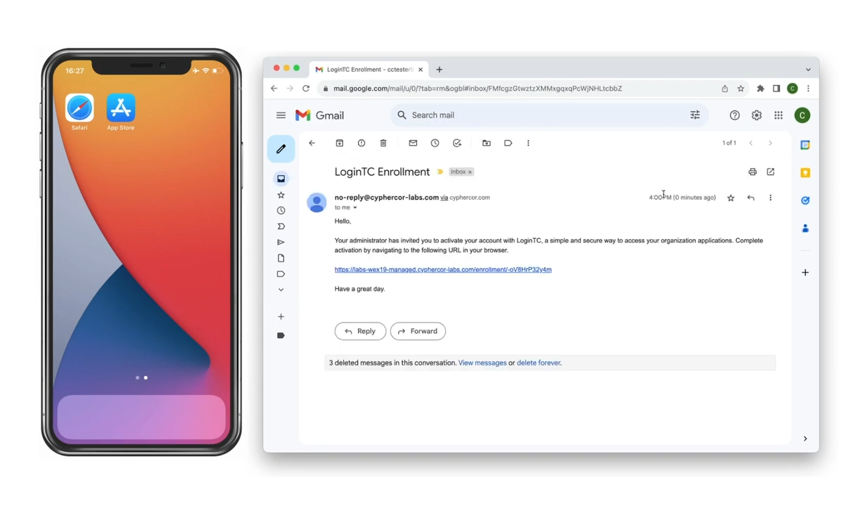
Getting Started: Enrollment Email
Look for an enrollment link from your IT administrator
Click the enrollment link in your email

Slide 3
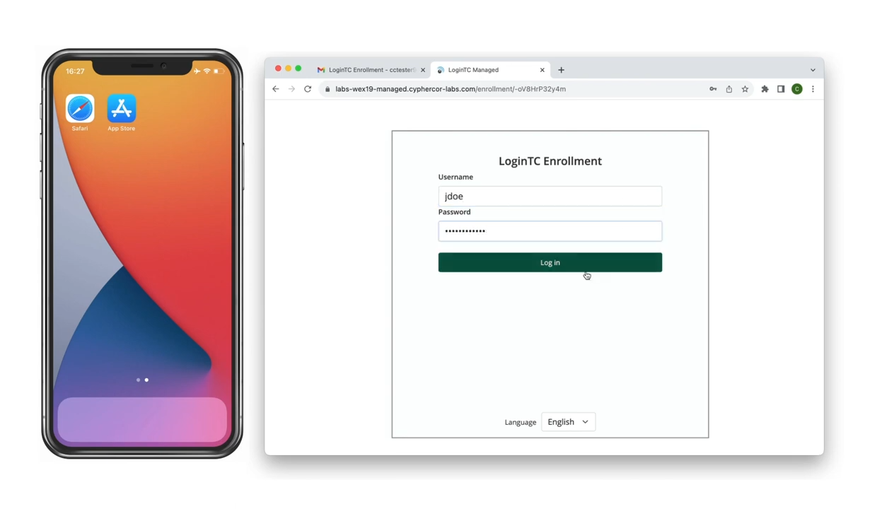
First Steps in the Enrollment Portal
Click "Start enrollment with LoginTC Managed"
You may need to enter your username and password

Slide 4
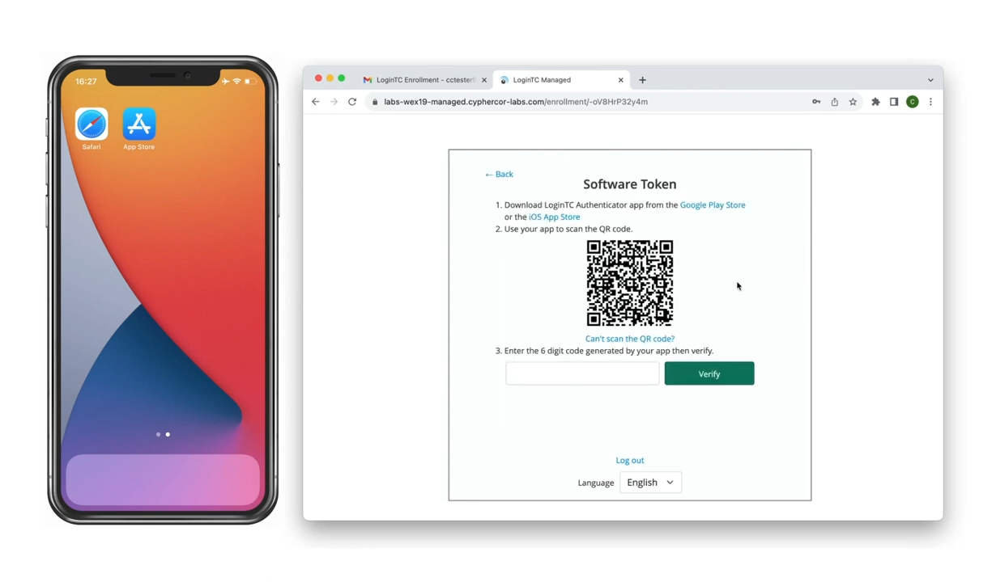
Choosing Your Authentication Method
Select "Software Token" from authentication methods
A QR code will appear on your screen

Slide 5
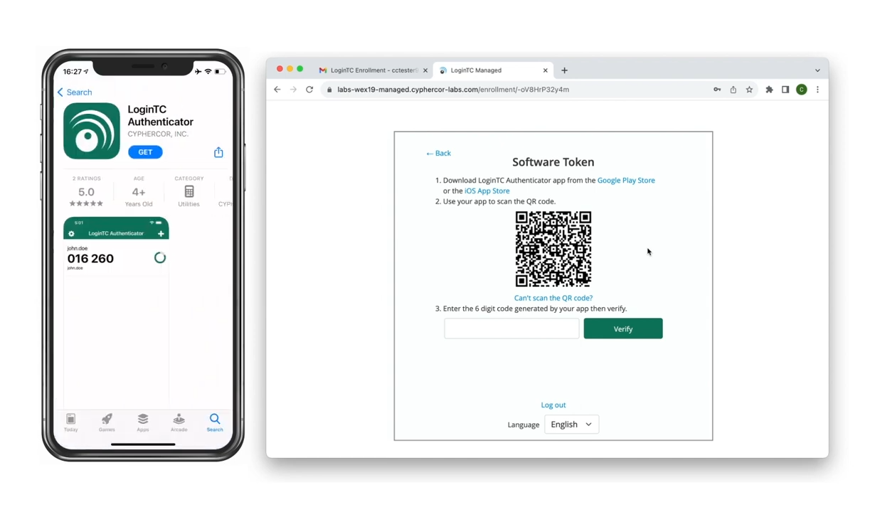
Download the Authenticator App
Open App Store (iOS or Android)
Search for "LoginTC Authenticator"
Look for the app by Cyphercor Incorporated
Install the green LoginTC Authenticator App

Slide 6
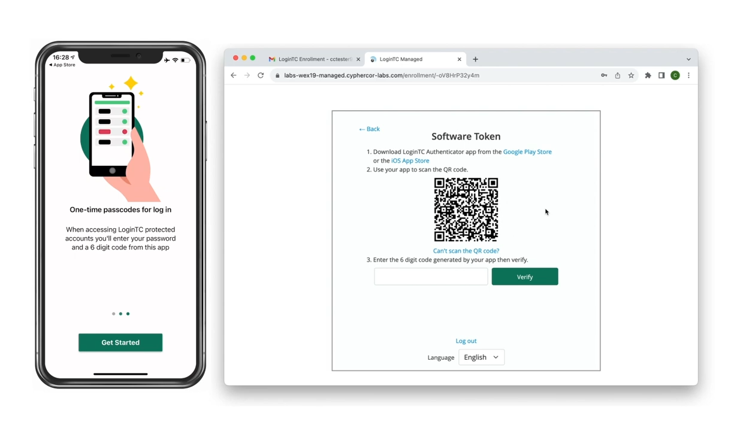
Setting Up the Authenticator App
Open the app
Swipe through introductory cards
Tap "Get Started"
Select "Scan QR Code"
Use your device's camera to scan the QR code

Slide 7
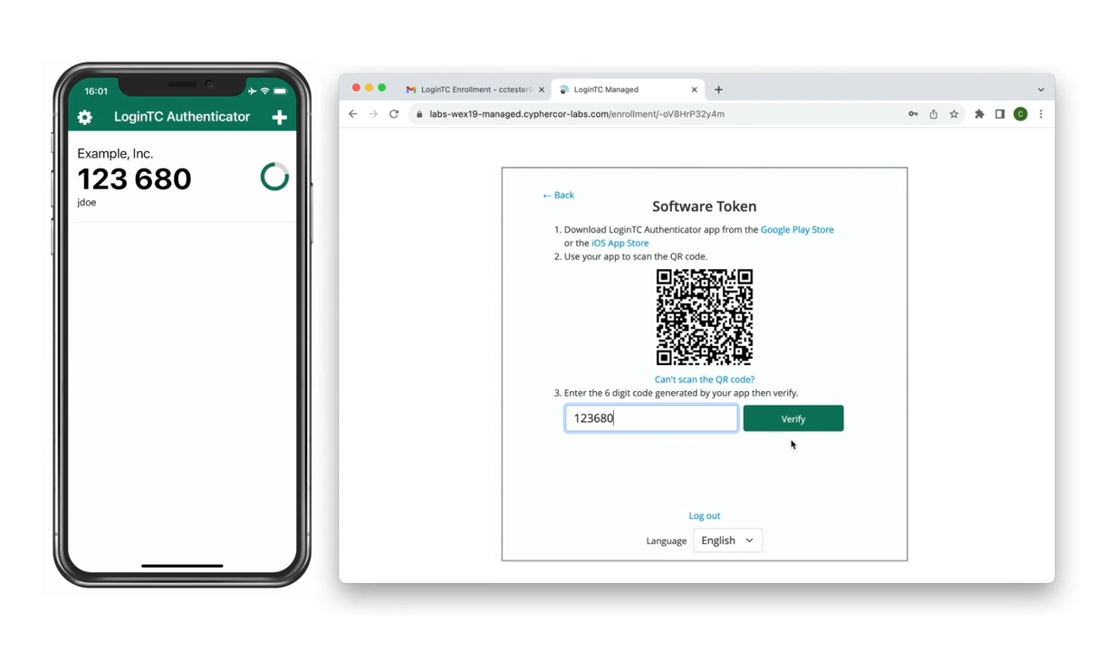
Verifying Your Setup
Enter the six-digit code from the app
Click "Verify" in your browser
Complete the enrollment process

Slide 8
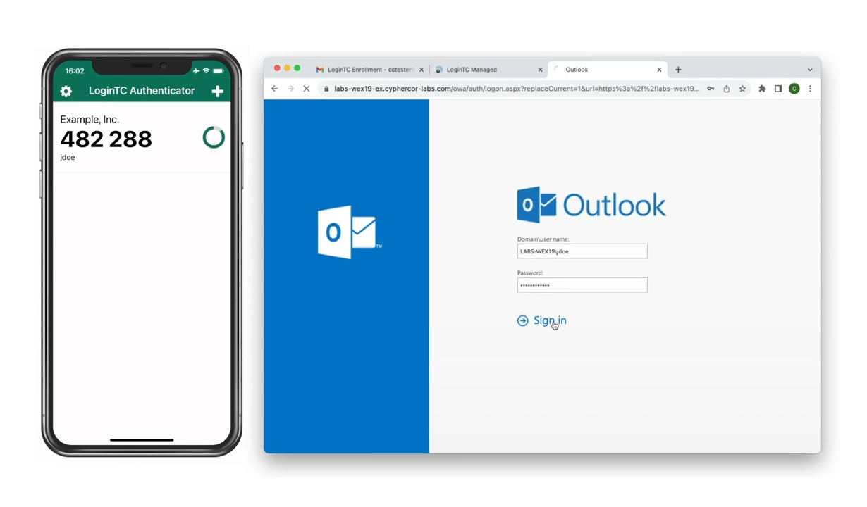
First Login with Multi-Factor Authentication
Go to your LoginTC protected application
Enter your first-factor credentials (username/password)
When prompted, enter the six-digit code from your app
Click "Log In"

