Slide 1
LoginTC Managed Enrollment with Passcode Grid
Notes:
Created from: https://www.youtube.com/watch?v=DXevg63CCUY

Slide 2
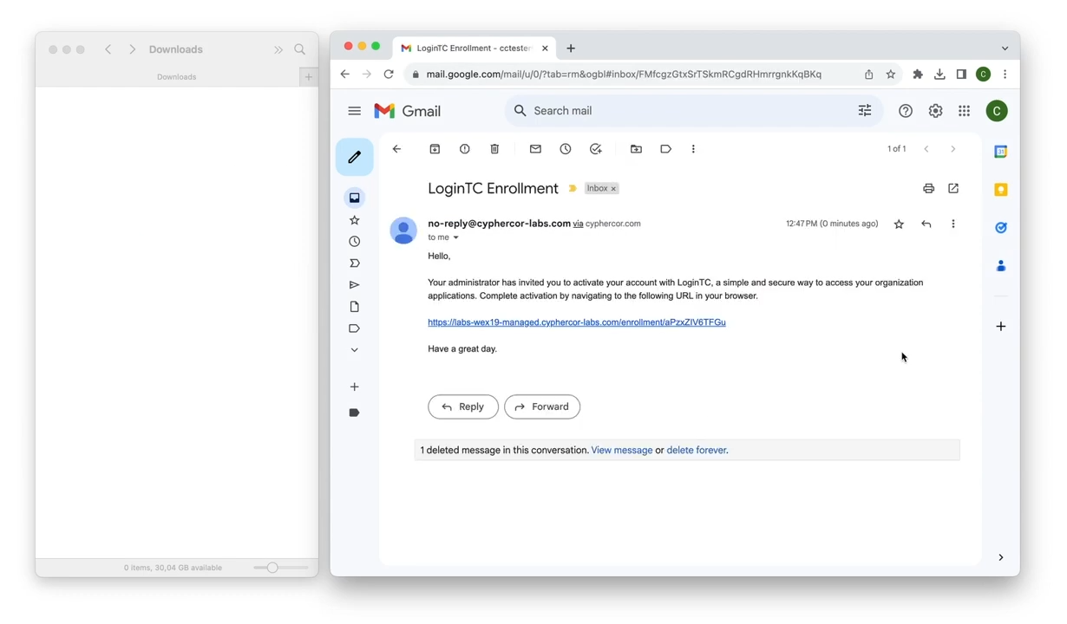
Begin Enrollment with LoginTC
Click enrollment link from IT administrator
Select "Start Enrollment"
First Factor: Enter username and password

Slide 3
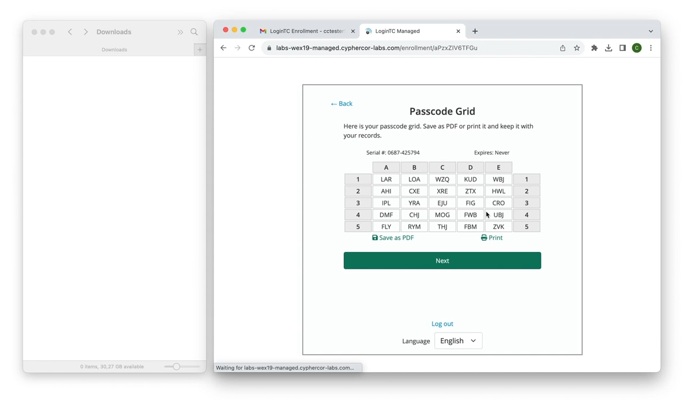
The Passcode Grid: Your New Security Tool
5x5 grid with three-letter groups (tuples)
Unique authentication method
Print or save grid securely

Slide 4
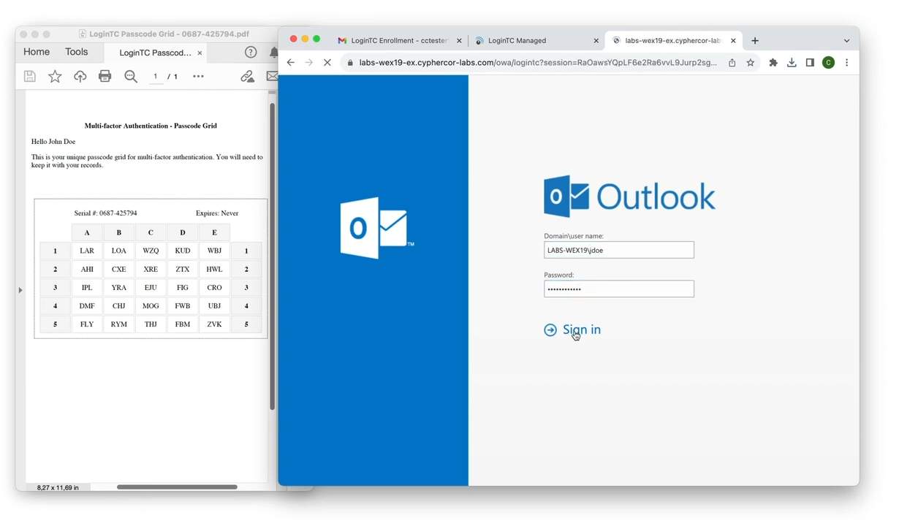
Authentication Process Step-by-Step
Enter first-factor credentials
Select "Passcode Grid" option
Input requested tuples
Click verify

Slide 5

Keeping Your Grid Secure
Never share your passcode grid
Store it in a safe place
Don't keep it near your computer

