Slide 1
MFA/2FA with Authentication App

Slide 2
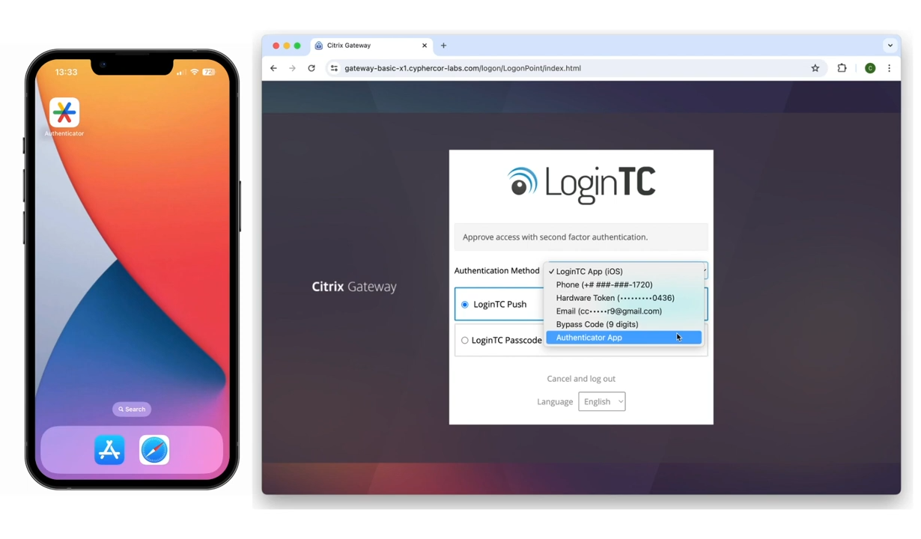
Authenticator App (Iframe mode)
Input first factor credentials
Select Authenticator App

Slide 3
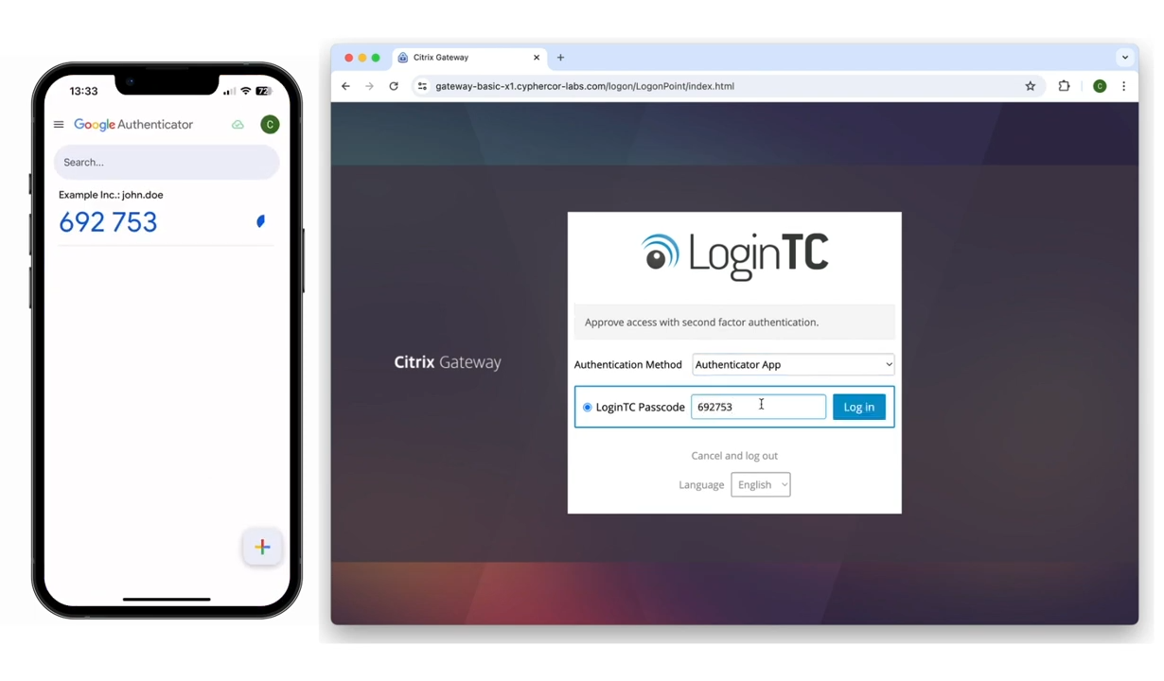
Approve Authenticator App (Iframe)
Open preferred authenticator app
Input code shown into the space provided
Click Log in

Slide 4
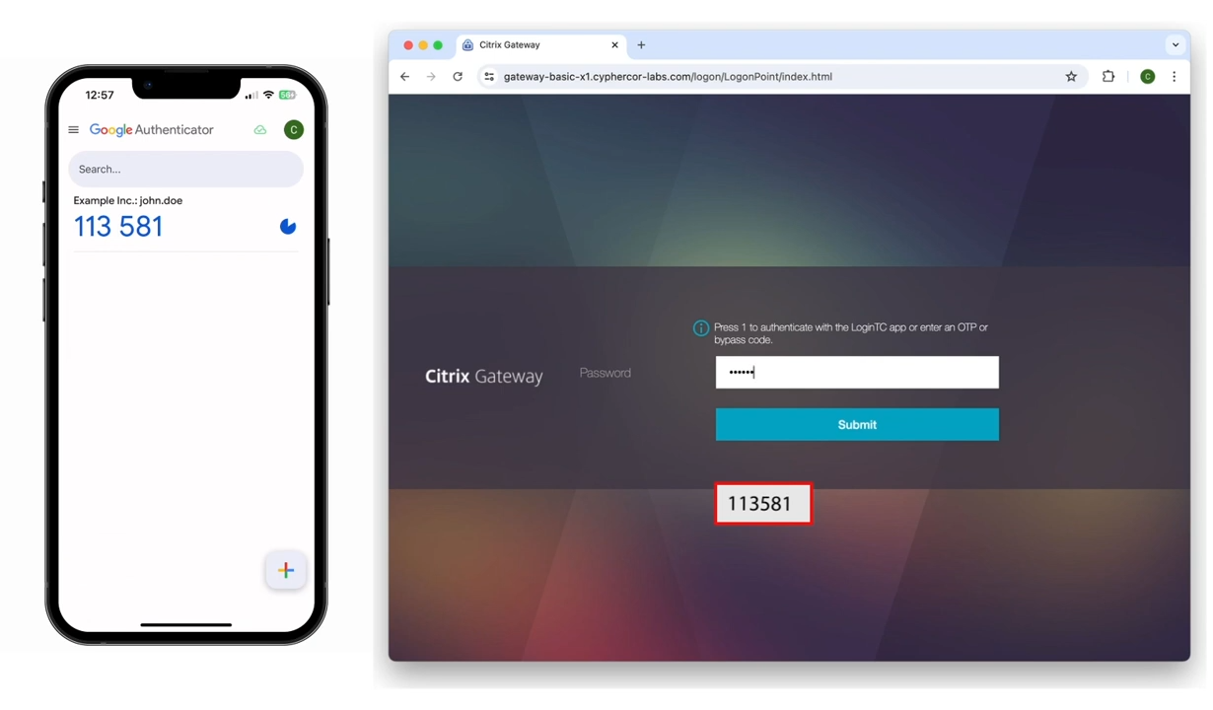
Authenticator App (Challenge Mode)
Input first factor credentials
Insert code shown on Authenticator App into the space provided
Click Submit

Slide 5
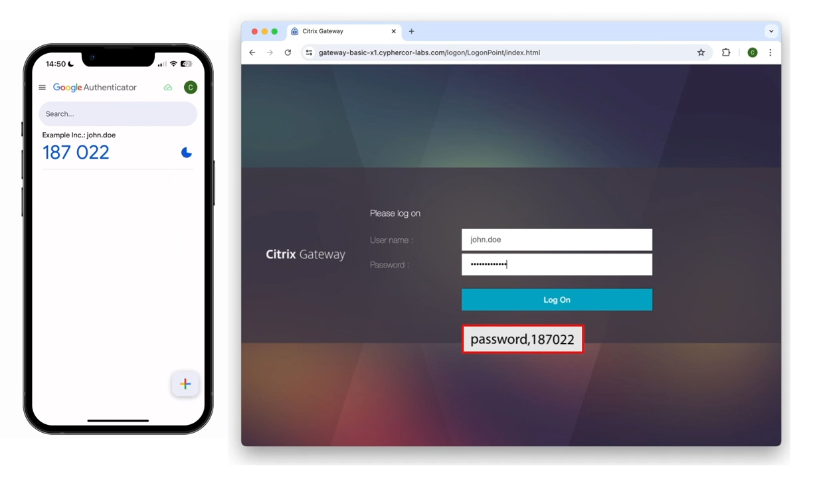
Authenticator App (Direct mode)
Input first factor credentials
In password field, type a comma followed by the code shown in your authenticator app
Click Log On

