Slide 1
Multi-Factor Authentication (2FA/MFA) UX with SMS OTP and Email OTP

Slide 2
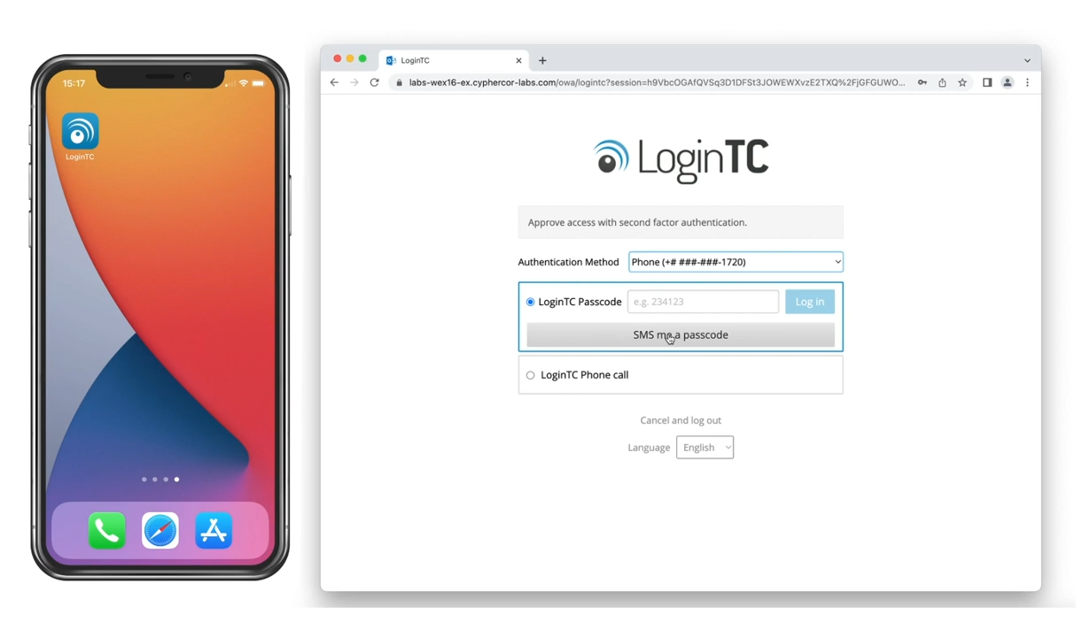
SMS One Time Password (Iframe mode)
Input first factor credentials
Select Phone from the dropdown list
Click “SMS me a passcode”

Slide 3
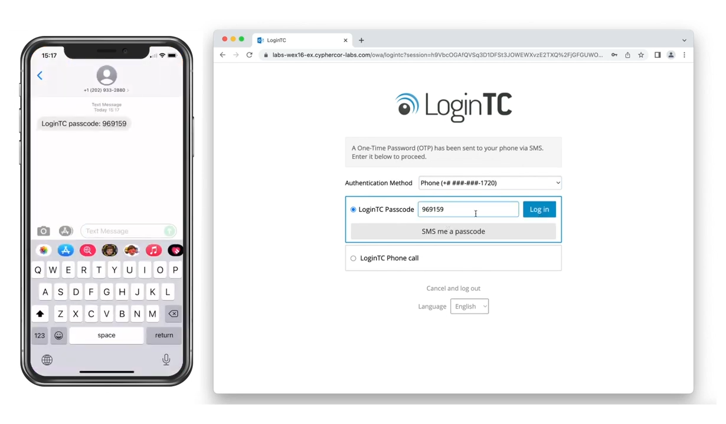
Approve SMS OTP
Input the code shown in your SMS text into the space provided
Click Log in

Slide 4
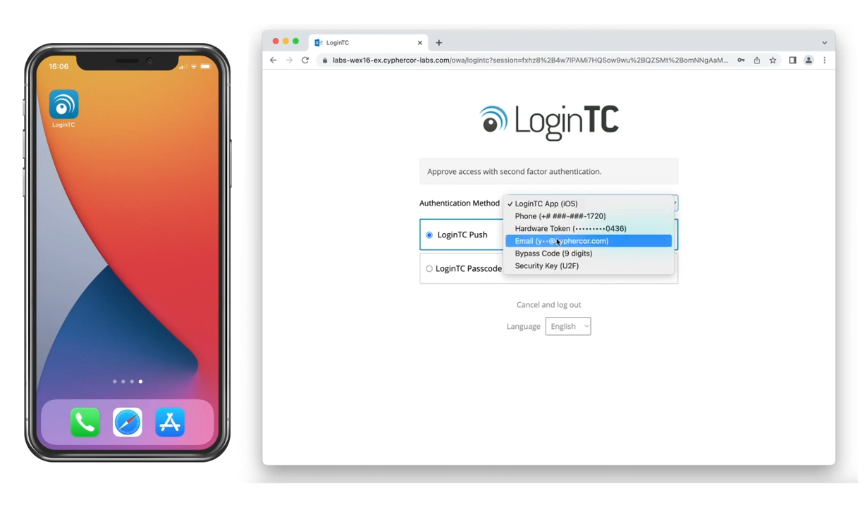
Email One Time Passcode (Iframe mode)
Input first factor credentials
Select Email from the dropdown list
Click “Email me a passcode”

Slide 5
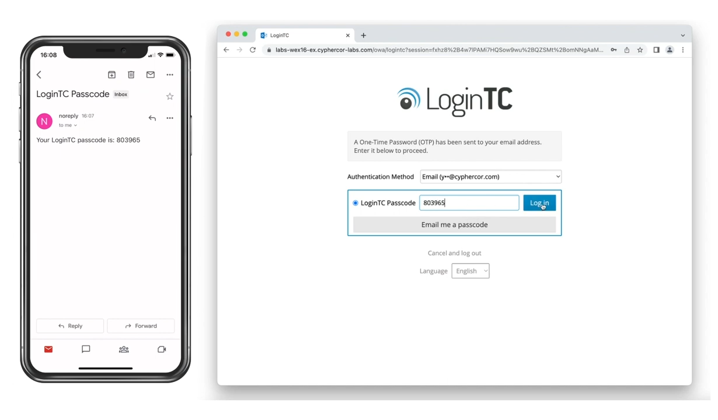
Approve Email OTP
Open email with the code
Input code into the space provided
Click Log in

Slide 6
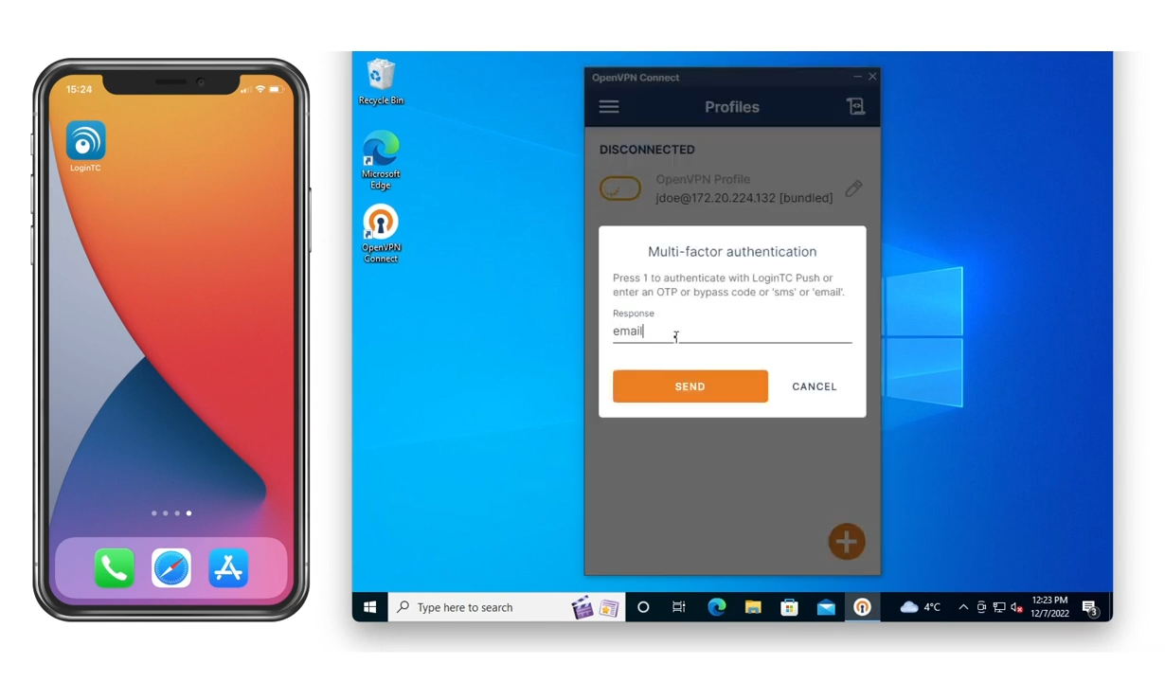
Email One Time Passcode (Challenge Interactive Mode)
Input first factor credentials
Type “email” into the space provided
Click Send

Slide 7
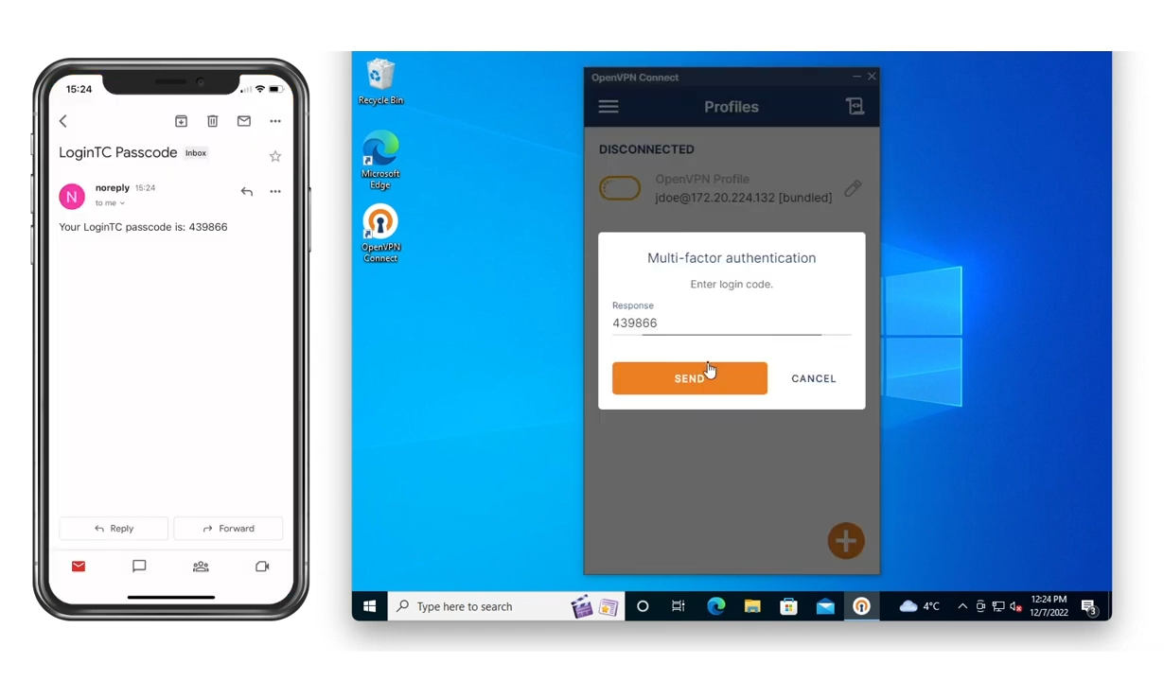
Approve Email OTP (Challenge Interactive)
Retrieve code from your email
Input code into the space provided
Click Send

Slide 8
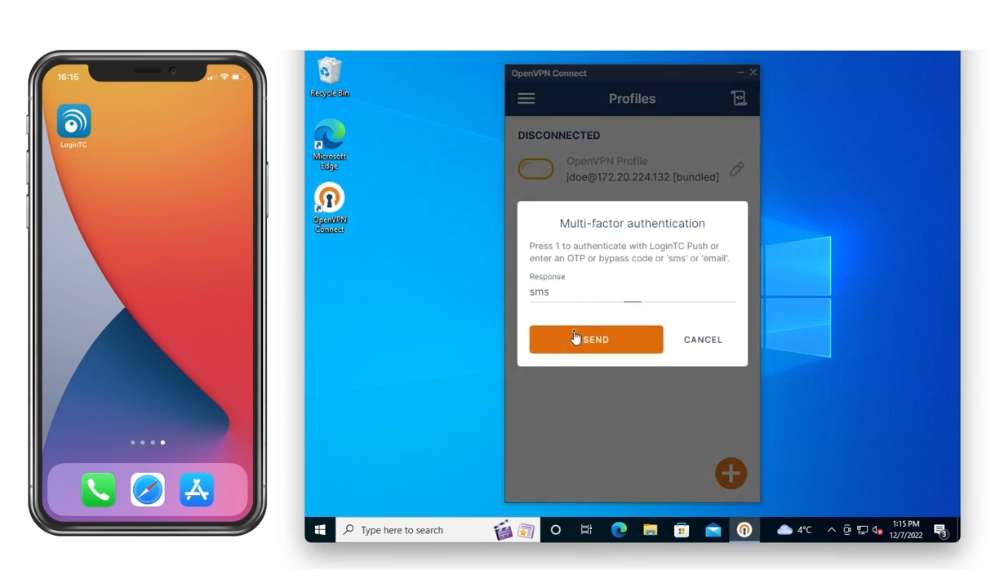
SMS One Time Passcode (Challenge Interactive)
Input first factor credentials
Type “sms” into the space provided
Click Send

Slide 9
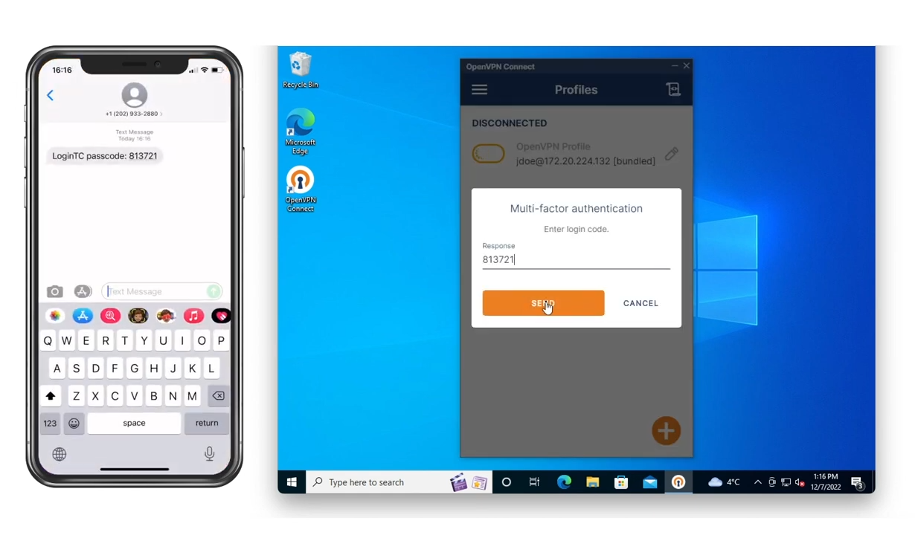
Approve SMS OTP (Challenge Interactive)
Input code from SMS into the space provided
Click Send

