Slide 1
Multi-Factor Authentication (2FA/MFA) UX with Software / Hardware OTP

Slide 2
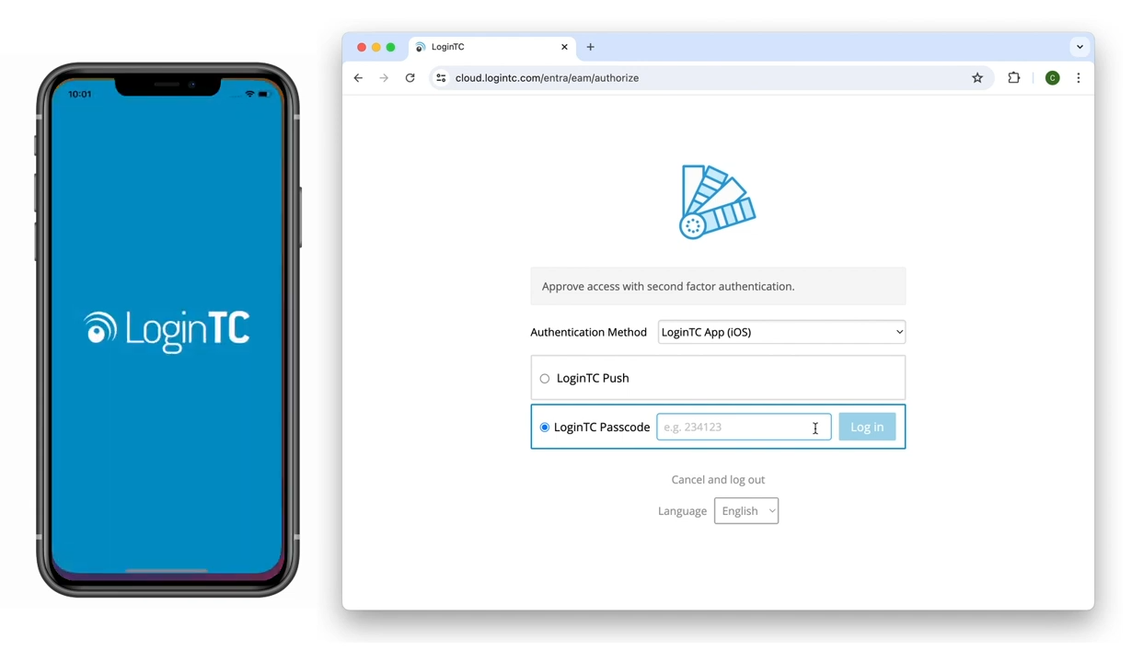
Software OTP
Input first factor credentials
Select LoginTC Passcode in the authentication window

Slide 3
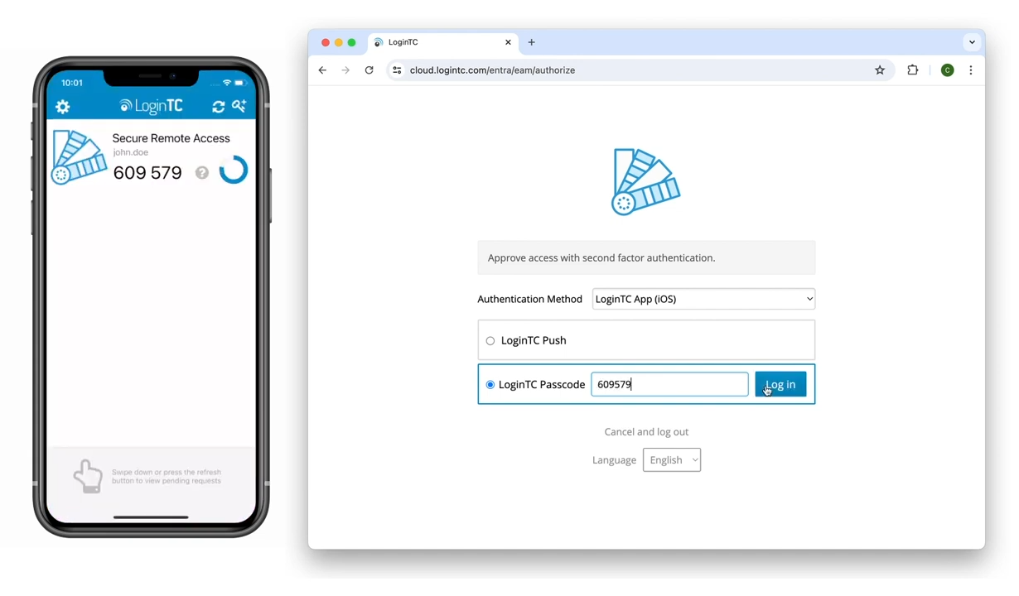
Approve Software OTP Request
Open your LoginTC App
Input the code shown into the space provided
Click Log In

Slide 4
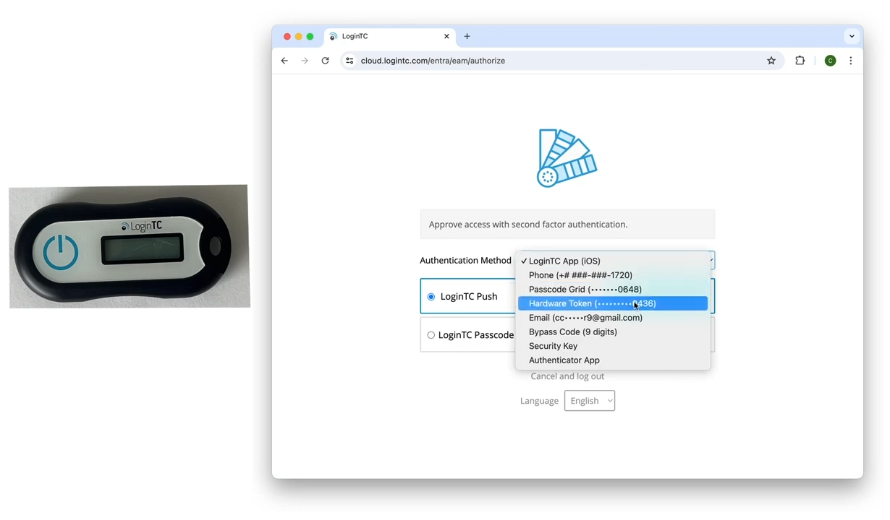
Hardware OTP
Input first factor credentials
Select Hardware Token in the authentication window

Slide 5
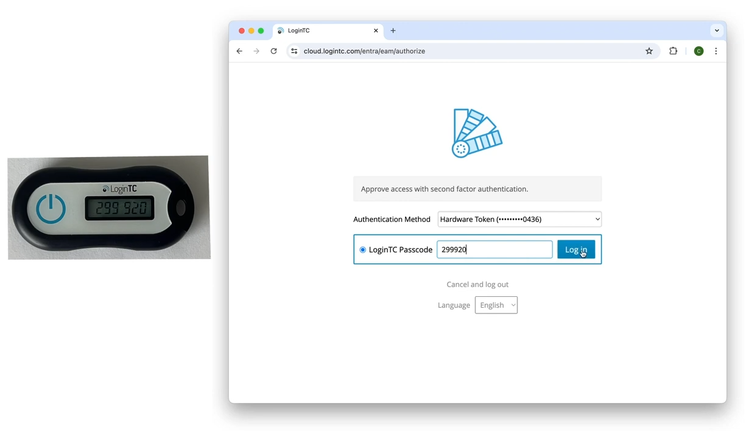
Approve Hardware OTP Request
Tap the button on your hardware token
Input the code shown into the space provided
Click Log in

