Slide 1
Multi-Factor Authentication (2FA/MFA) User Experience with LoginTC Desktop

Slide 2
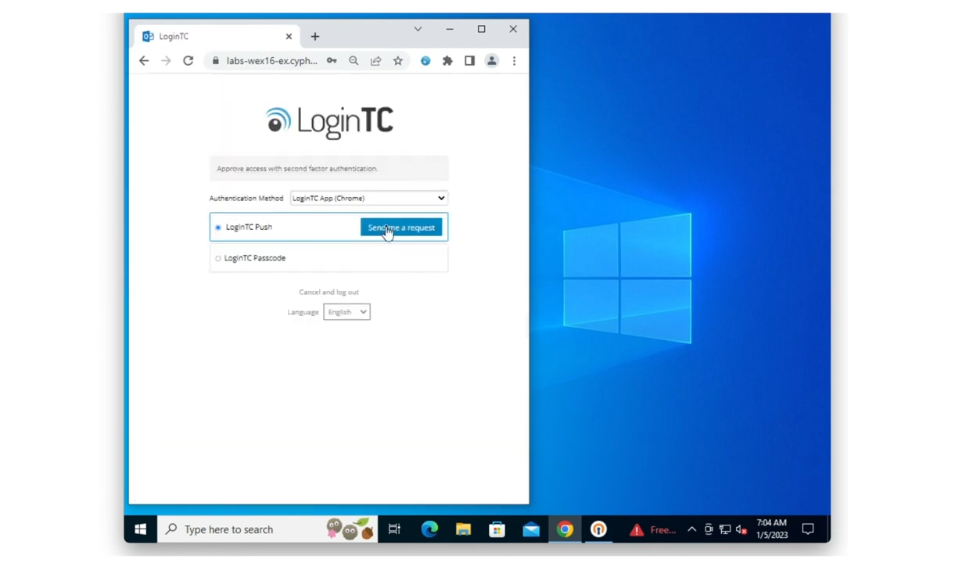
Desktop Push Authentication
Input username and password
With LoginTC APP (Chrome) selected
Click Send me a Request in LoginTC Push

Slide 3
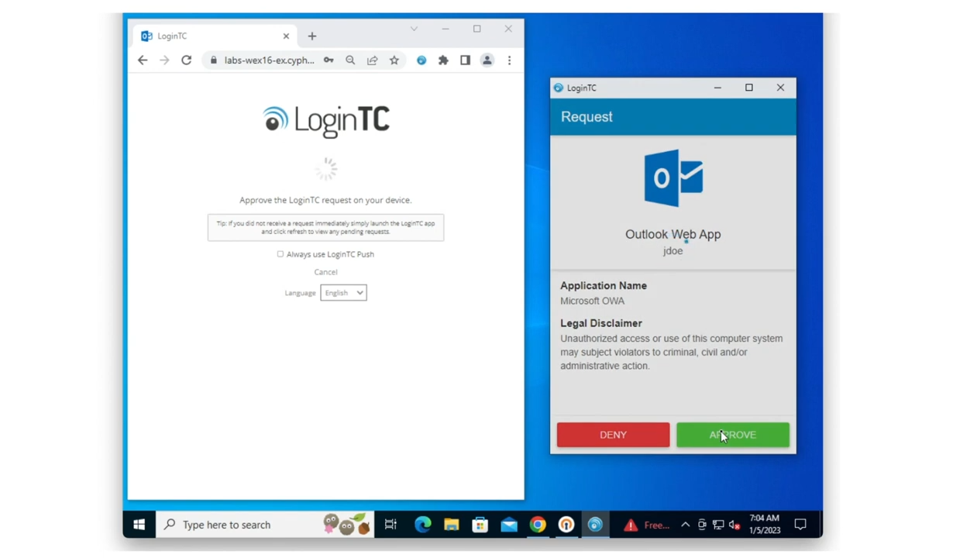
Approve Desktop Push Request
Click on the authentication request notification in the corner of your screen.
In the authentication window that appears, click Approve.

Slide 4
Desktop Push Number Matching
Input username and password
With LoginTC APP (Chrome) selected
Click Send me a Request in LoginTC Push

Slide 5
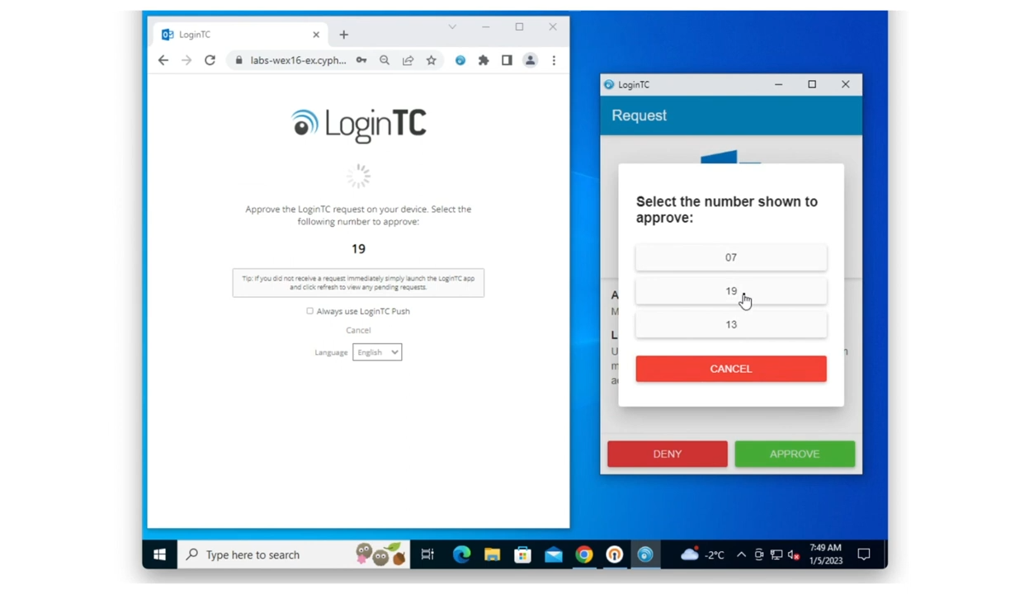
Approve Number Matching Request
Note the number that appears on the protected application.
Click on the authentication request notification
Click Approve
Select the matching number

