Slide 1
Multi-Factor Authentication (2FA/MFA) User Experience with Passcode Grid

Slide 2
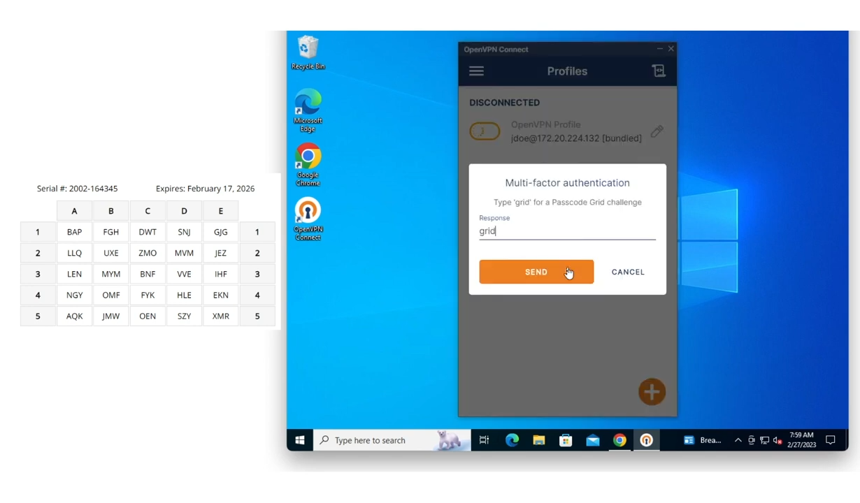
Passcode Grid (Challenge Interactive mode)
Input first factor credentials
Type ‘grid’ to receive a passcode grid challenge

Slide 3

Accept Passcode Grid Challenge
Correlate requested coordinates with tuples on your personal passcode grid
This request asks for “E2-D3-C2” which corresponds to JEZ-VVE-ZMO on this user’s passcode grid
Input that into the space provided and click Send

Slide 4
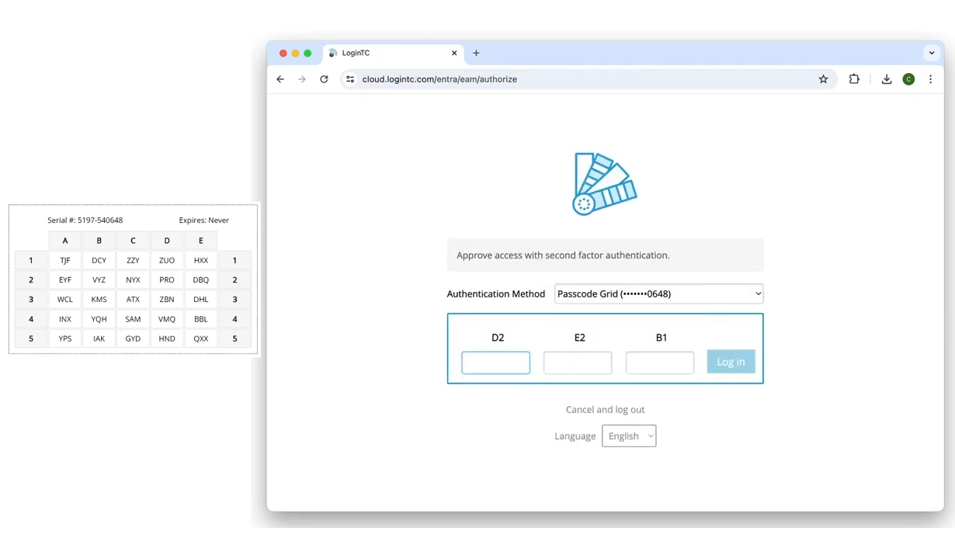
Passcode Grid (Iframe mode)
Input first factor credentials
Select Passcode Grid from the dropdown menu

Slide 5
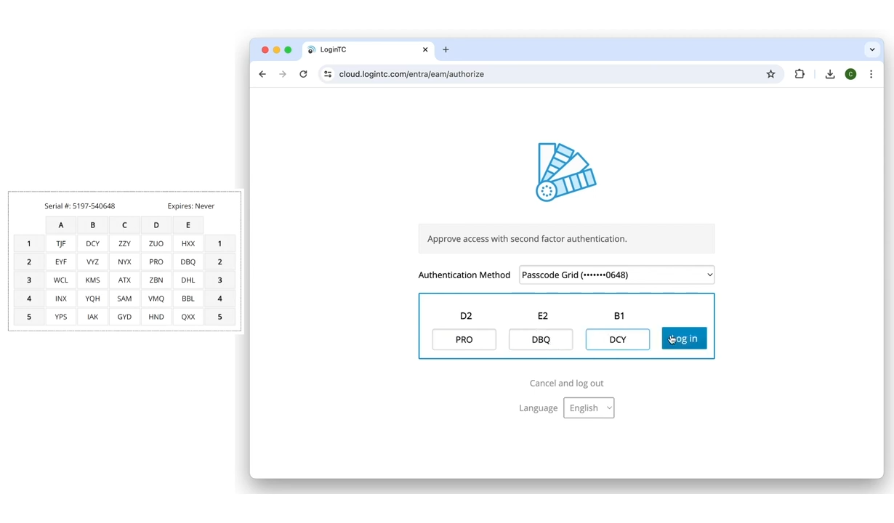
Accept Passcode Grid Challenge
Correlate requested coordinates with tuples on your personal passcode grid
This request asks for “D2-E2-B1” which corresponds to PRO-DBQ-DCY on this user’s passcode grid
Input that into the space provided and click Log In

