Slide 1
Multi-Factor Authentication (2FA/MFA) User Experience with Push

Slide 2
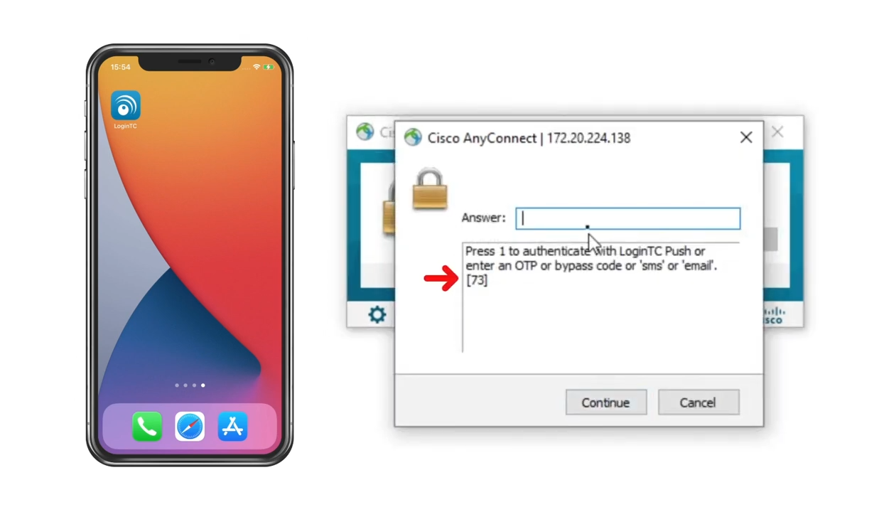
Push Number Matching (Challenge Mode)
Connect to the VPN
Input username and password
Authentication request will include the number to match

Slide 3
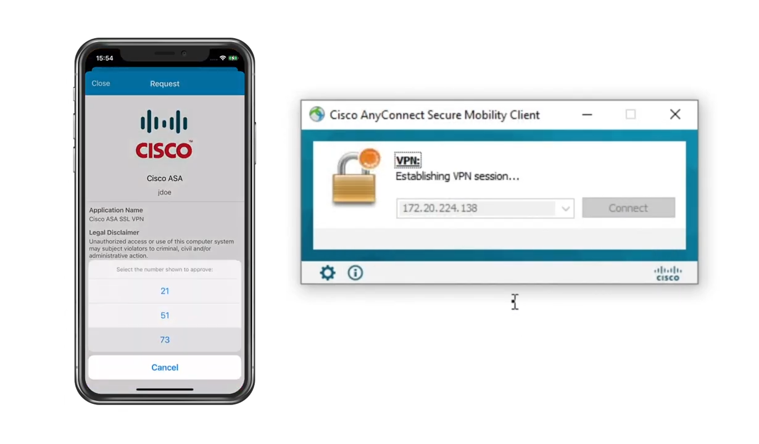
Confirm Push Authentication
Input 1 and click Continue to receive request
On your LoginTC App, click Approve on the request
Select the number that matches
Click Approve to confirm

Slide 4
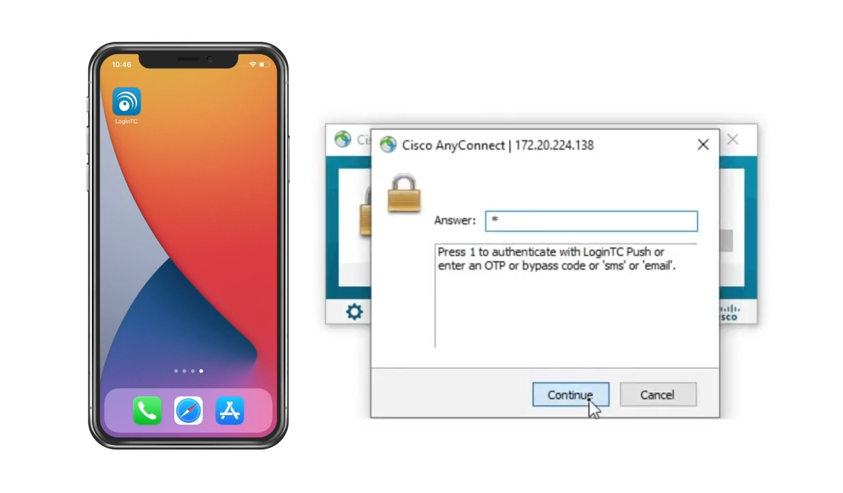
Push Number Matching Authentication (Challenge Mode)
Connect to the VPN
Input username and password
Type 1 and click Continue to receive authentication request

Slide 5
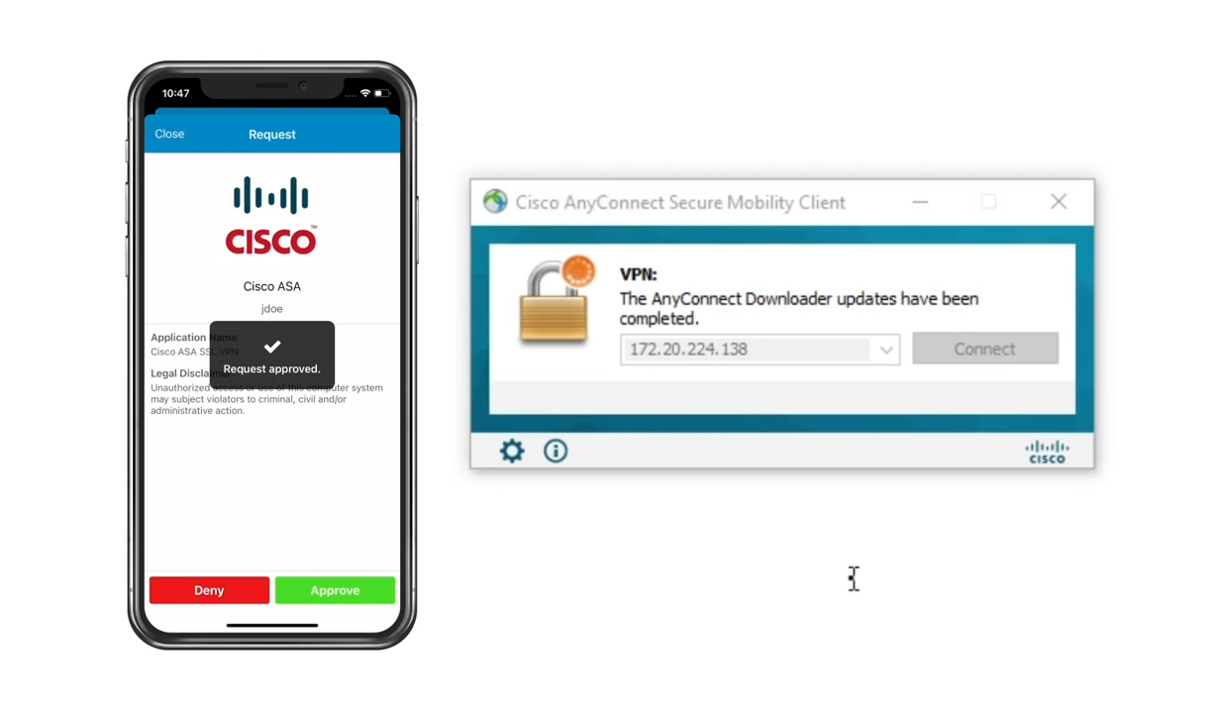
Confirm Push Authentication
Approve request that appears on your LoginTC App
Optional: Type pin to approve

Slide 6
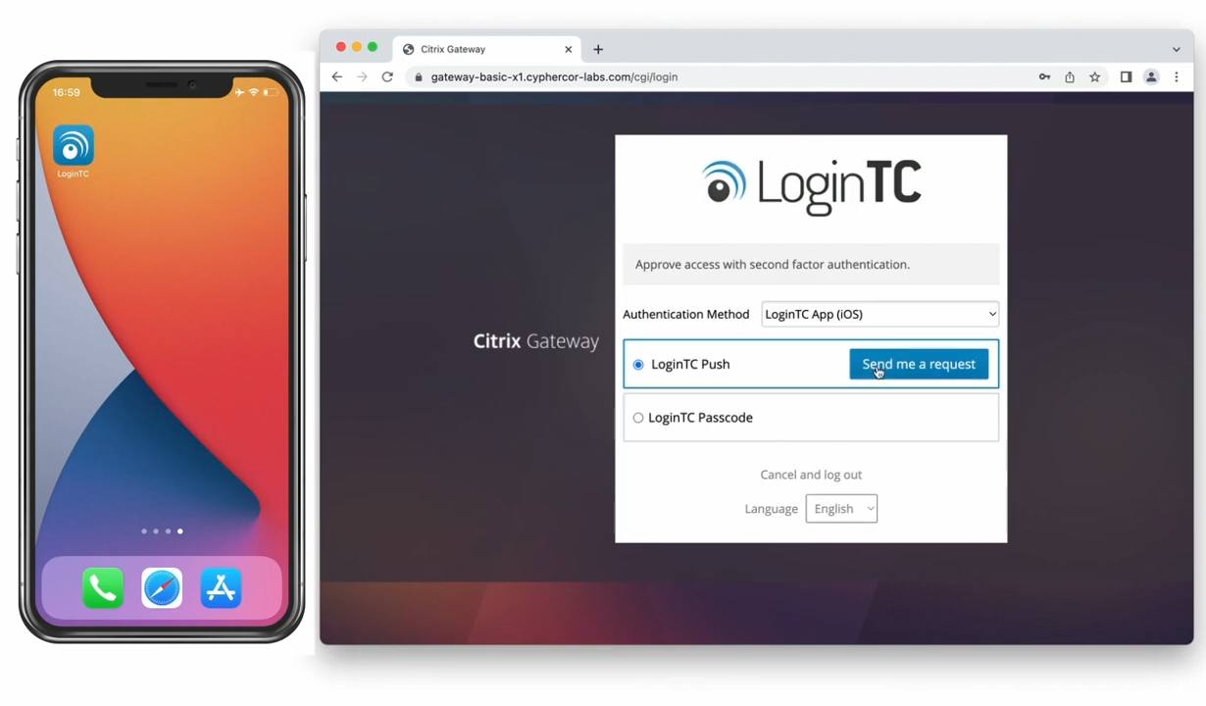
Push Number Matching Authentication (Iframe mode)
Input username and password
Select LoginTC Push
Click Send me a Request

Slide 7
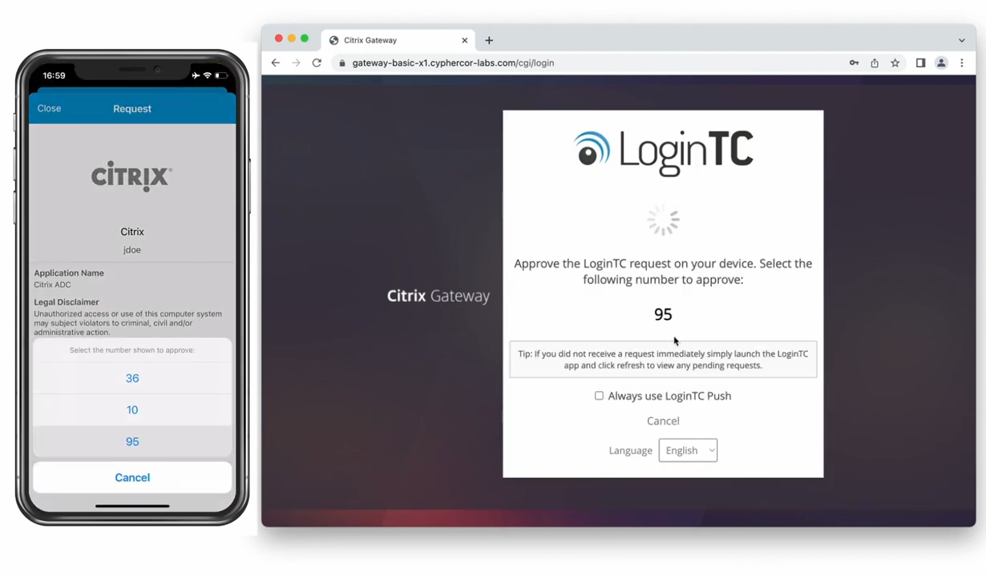
Confirm Push Authentication
On LoginTC App, tap Approve
Select the number that matches

Slide 8
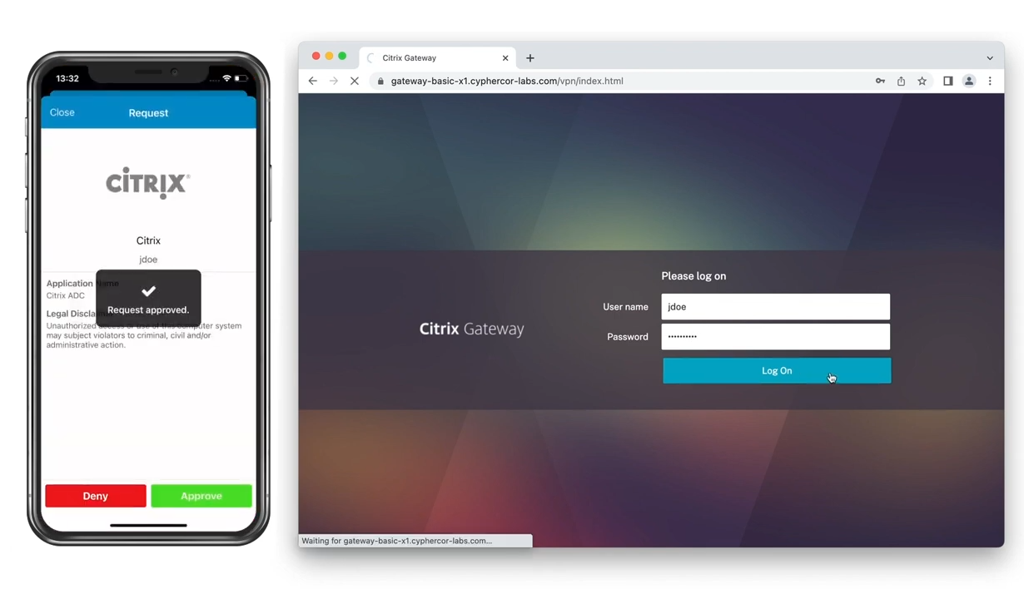
Push Authentication (Direct Mode)
Input username and password
Immediately receive a Push Authentication request
Approve the request

