Slide 1
Multi-Factor Authentication (MFA) User Experience with Security Key

Slide 2
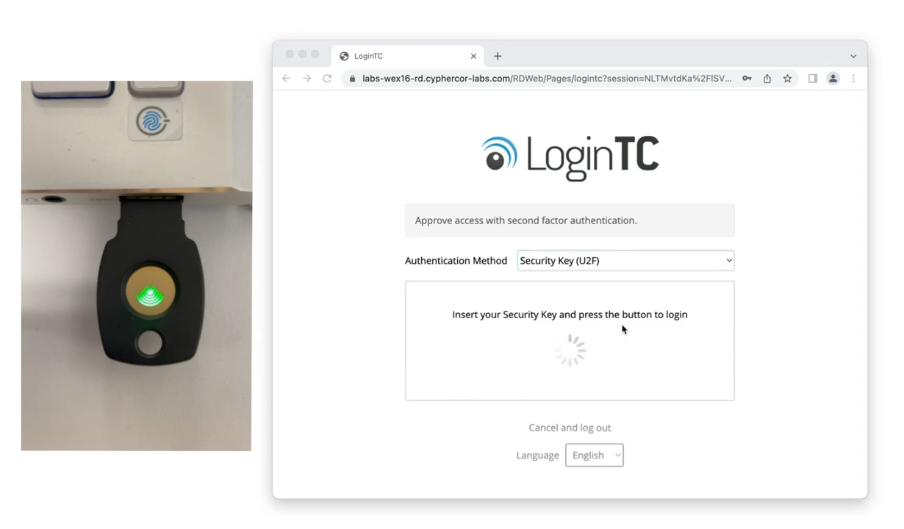
Security Key Authentication
Input first factor credentials
Select Security Key

Slide 3
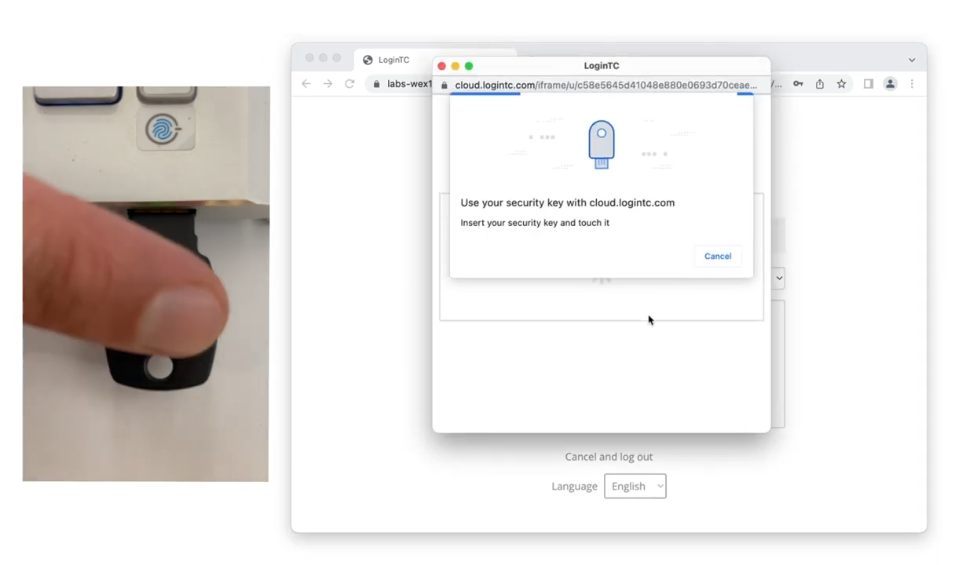
Approve Security Key Authentication
Inset your security key
Tap the button to authenticate

